Slide 1
Interactive Visual Data Analysis
08 – Visualization of geo-spatial data

Slide 2
Objectives
How to deal with space: Learn about data with spatial dependencies
How to visualize data with a spatial frame of reference: Learn visualization techniques for geo-spatial data

Slide 3
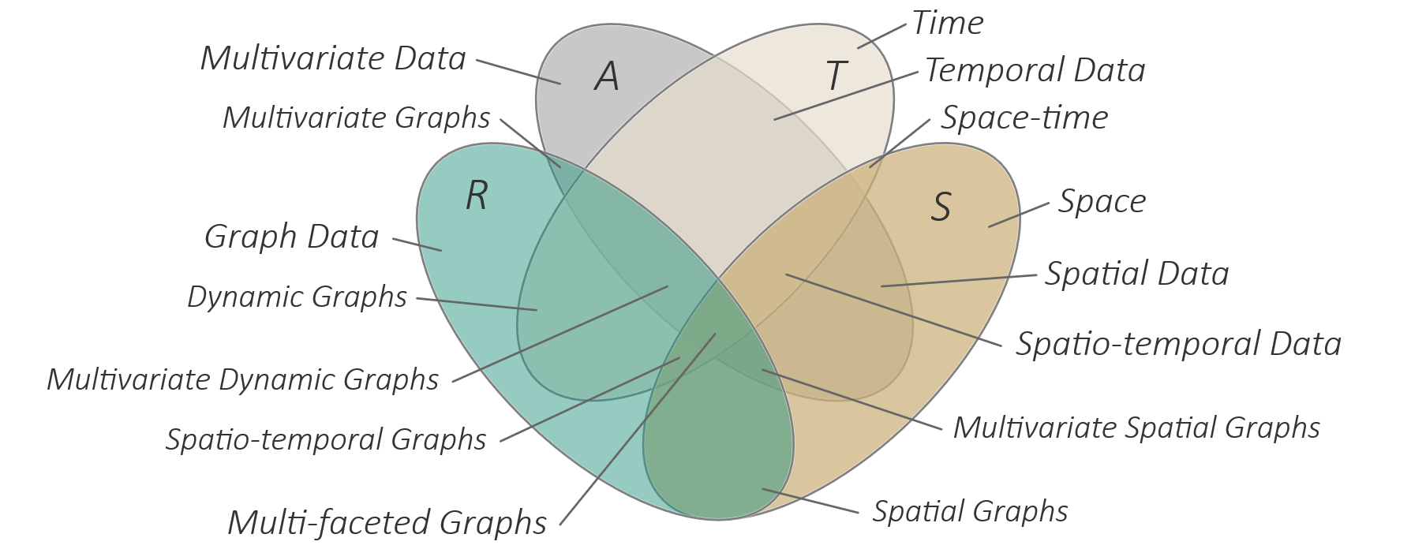
Overview
Visualization of geo-spatial data
Geographic space and geo-spatial data
General visualization strategies
Representing geo-space
Representing data in geo-space
Visualizing spatio-temporal data (S and T)

Slide 4
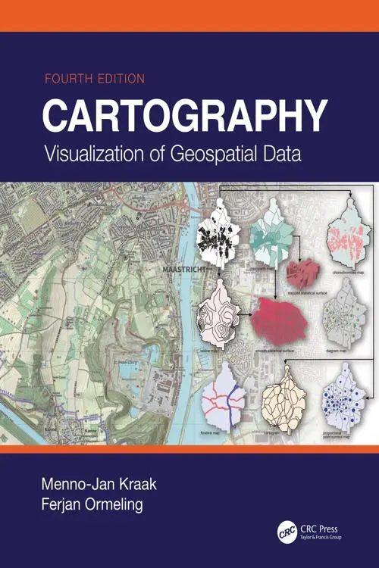
Visualization of geo-spatial data
Space is vitally important for understanding many phenomena
Geo-spatial data omnipresent in many domains
Many data analyses seek to understand data in their spatial frame of reference: “How do data attributes behave in space: S → A ?”
For appropriate visualization, we need to know
Characteristics of space and geo-spatial data
Analytical questions being asked for geo-spatial data
Visualization techniques taking specifics of space into account
Note again: One can fill a whole book with this topic

Slide 5
Geographic space and geo-spatial data
Geographic space characterized by
Dimensionality
Scale
Geo-spatial data associated with
Spatial units

Slide 6
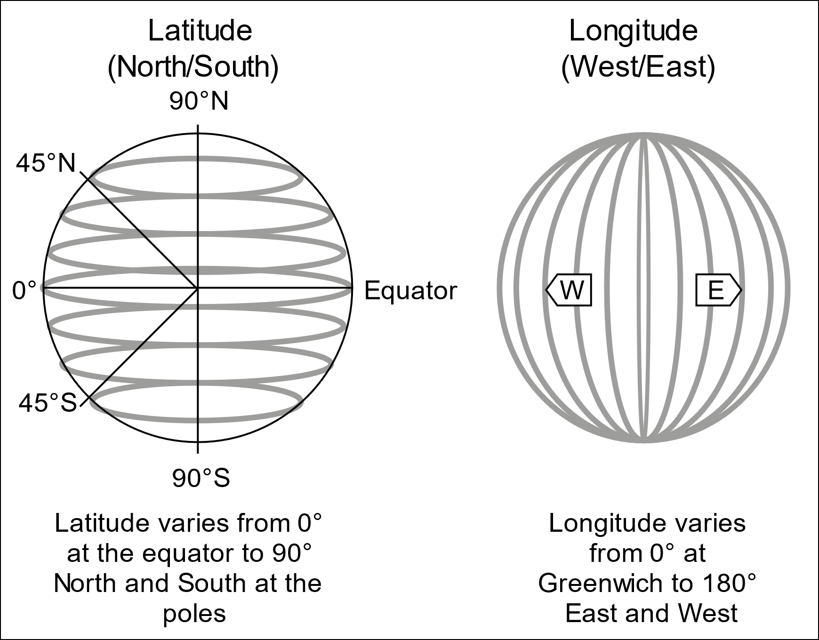
Geographic space
Geographic space characterized by
Dimensionality
Three-dimensional
Latitude (90° north pole, 0° equator, -90° south pole)
Longitude (0° Greenwich, positive angles eastward, negative angles westward)
Elevation (above sea level)
Often latitude and longitude are sufficient (e.g., weather data)
For some applications elevation is crucial (e.g., air traffic)
https://commons.wikimedia.org/wiki/File:FedStats_Lat_long.svg

Slide 7
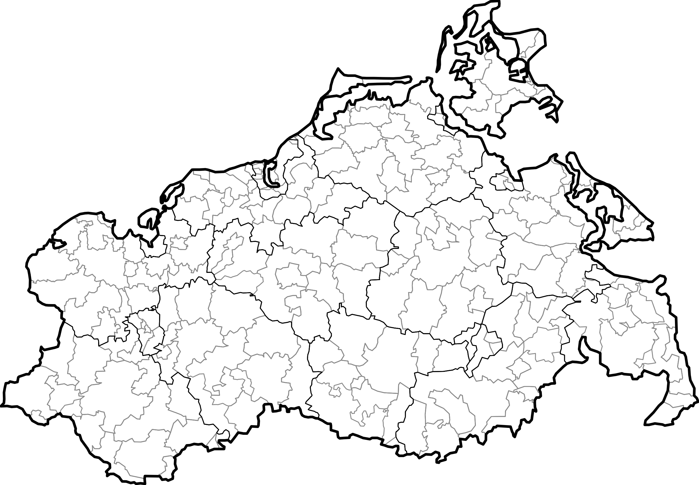
Geographic space
Geographic space characterized by
Scale
Geographic space is continuous and infinite wrt. resolution
Data collection and data analysis based on discrete spatial units
Single scale (e.g., simple points)
Multiple scales (e.g., hierarchical structure of administrative partitions of space: federal state, districts, zip-code regions)
Phenomena can be observable at different scales
Finding the right scale can be part of the data analysis

Slide 8
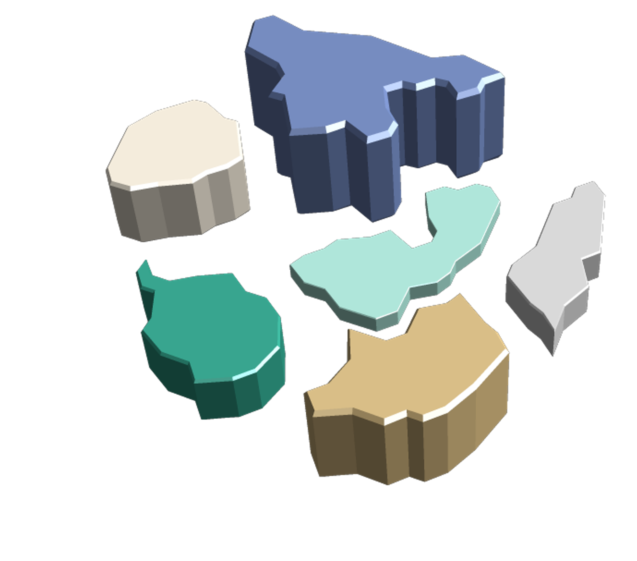
Geo-spatial data
Geo-spatial data associated with
Spatial units
Points (e.g., weather data)
Lines (e.g., traffic data)
Areas (e.g., census data)
Volumes (e.g., hurricane data)
According to the first law of geography, geo-spatial data are usually valid in a local scope around spatial units
Recall data scope from Lecture 2.

Slide 9
Geo-spatial data
First law of geography
Important consequences
Geo-spatial data can usually be interpolated and extrapolated
Visual representation of a geo-spatial data value can spread in certain neighborhood
“
[…] everything is related to everything else, but near things are more related than distant things. — Tobler, 1970

Slide 10
Analytical questions for geo-spatial data
Many different questions can be asked wrt. geo-spatial data
Think about: What questions would you think of?
Where are data values located in space?
What values are present in a certain region?
How are data values distributed in space?
Do patterns re-occur spatially?
…

Slide 11
General visualization strategies
Visualizing geo-spatial data requires:
Representing geo-space
Representing data in geo-space

Slide 12
Representing geo-space
In order to understand geo-spatial data, we need a visual representation of geographic space, typically represented as a map
Cartography is the science of making and using maps (Full coverage beyond the scope of this lecture)
Here, we focus on selected technical questions of drawing maps
For drawing a map, we need map data in a suitable format:
Geo-JSON
Topo-JSON

Slide 13
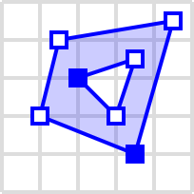
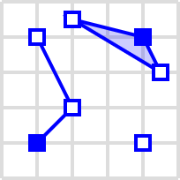
Representing geo-space
First array of coordinates defines outer shape of polygon. Further arrays define holes in the outer shape.
Geo-JSON
Geometry primitives
Point, MultiPoint
LineString, MultiLineString
Polygon, MultiPolygon
GeometryCollection
Geographic features
Spatially bounded object
Geometry (as defined above)
Properties (any data about the object)
{ "type": "Polygon", "coordinates": [ [[35.0, 10.0], [45.0, 45.0], [15.0, 40.0], [10.0, 20.0], [35.0, 10.0]], [[20.0, 30.0], [35.0, 35.0], [30.0, 20.0], [20.0, 30.0]] ] }
{ "type": "GeometryCollection", "geometries": [ { "type": "Point", "coordinates": [40.0, 10.0] }, { "type": "LineString", "coordinates": [ [10.0, 10.0], [20.0, 20.0], [10.0, 40.0] ] }, { "type": "Polygon", "coordinates": [ [[40.0, 40.0], [20.0, 45.0], [45.0, 30.0], [40.0, 40.0]] ] } ] }
https://en.wikipedia.org/wiki/GeoJSON

Slide 14
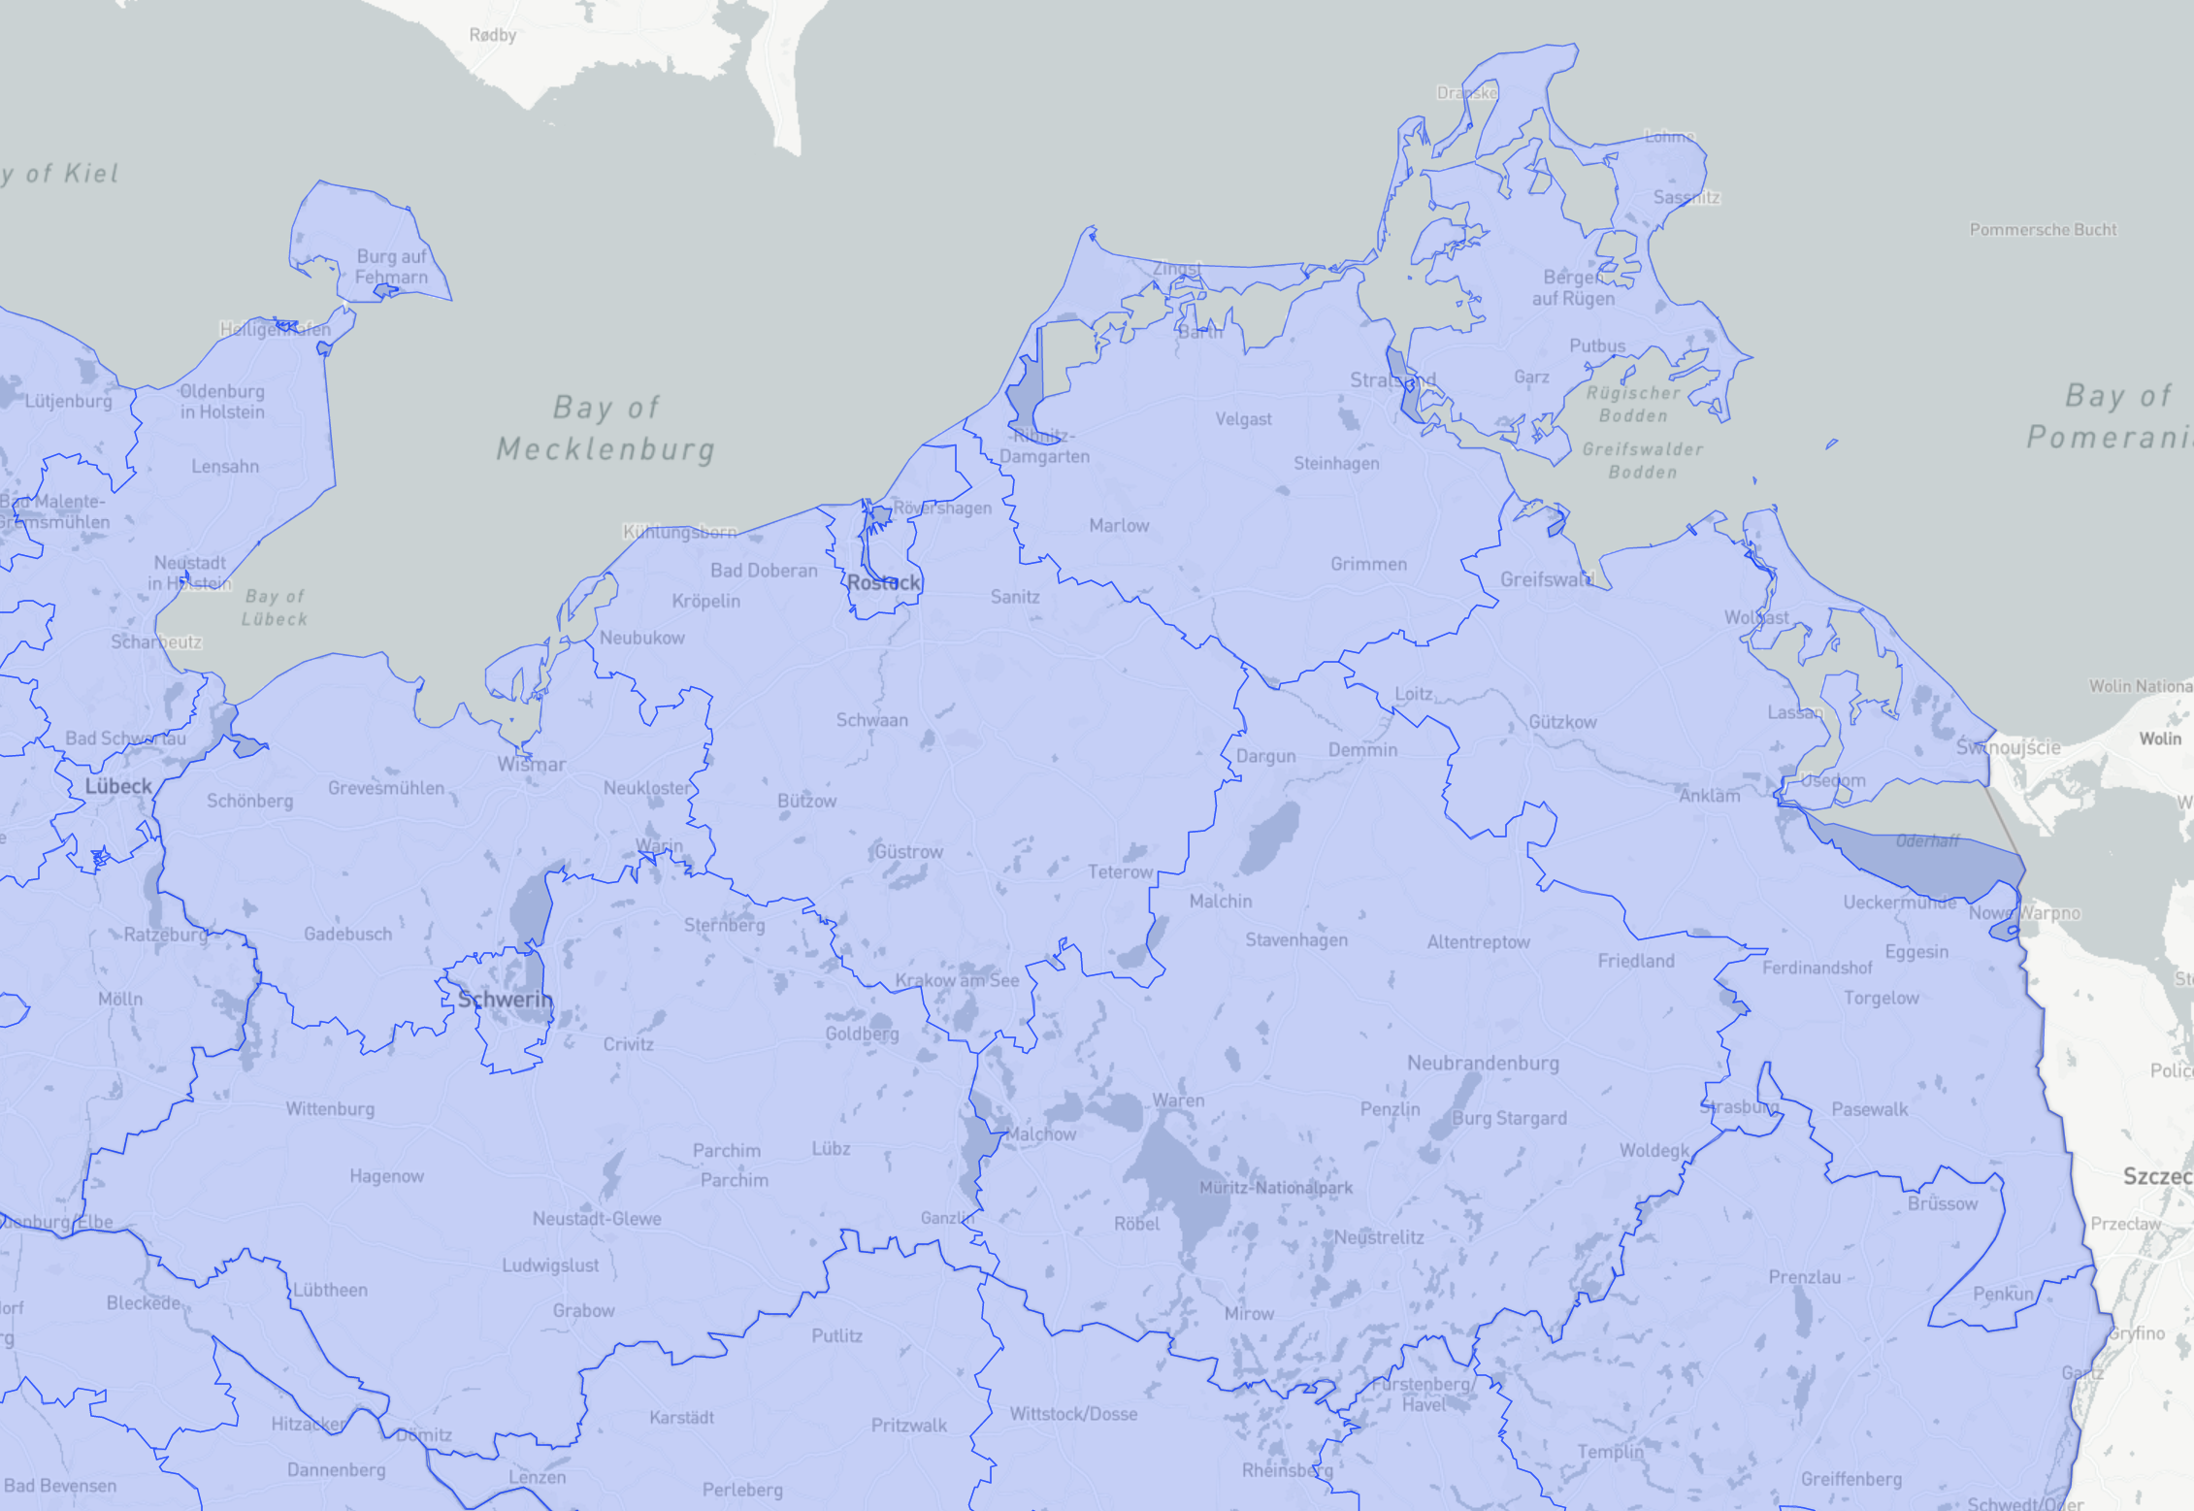
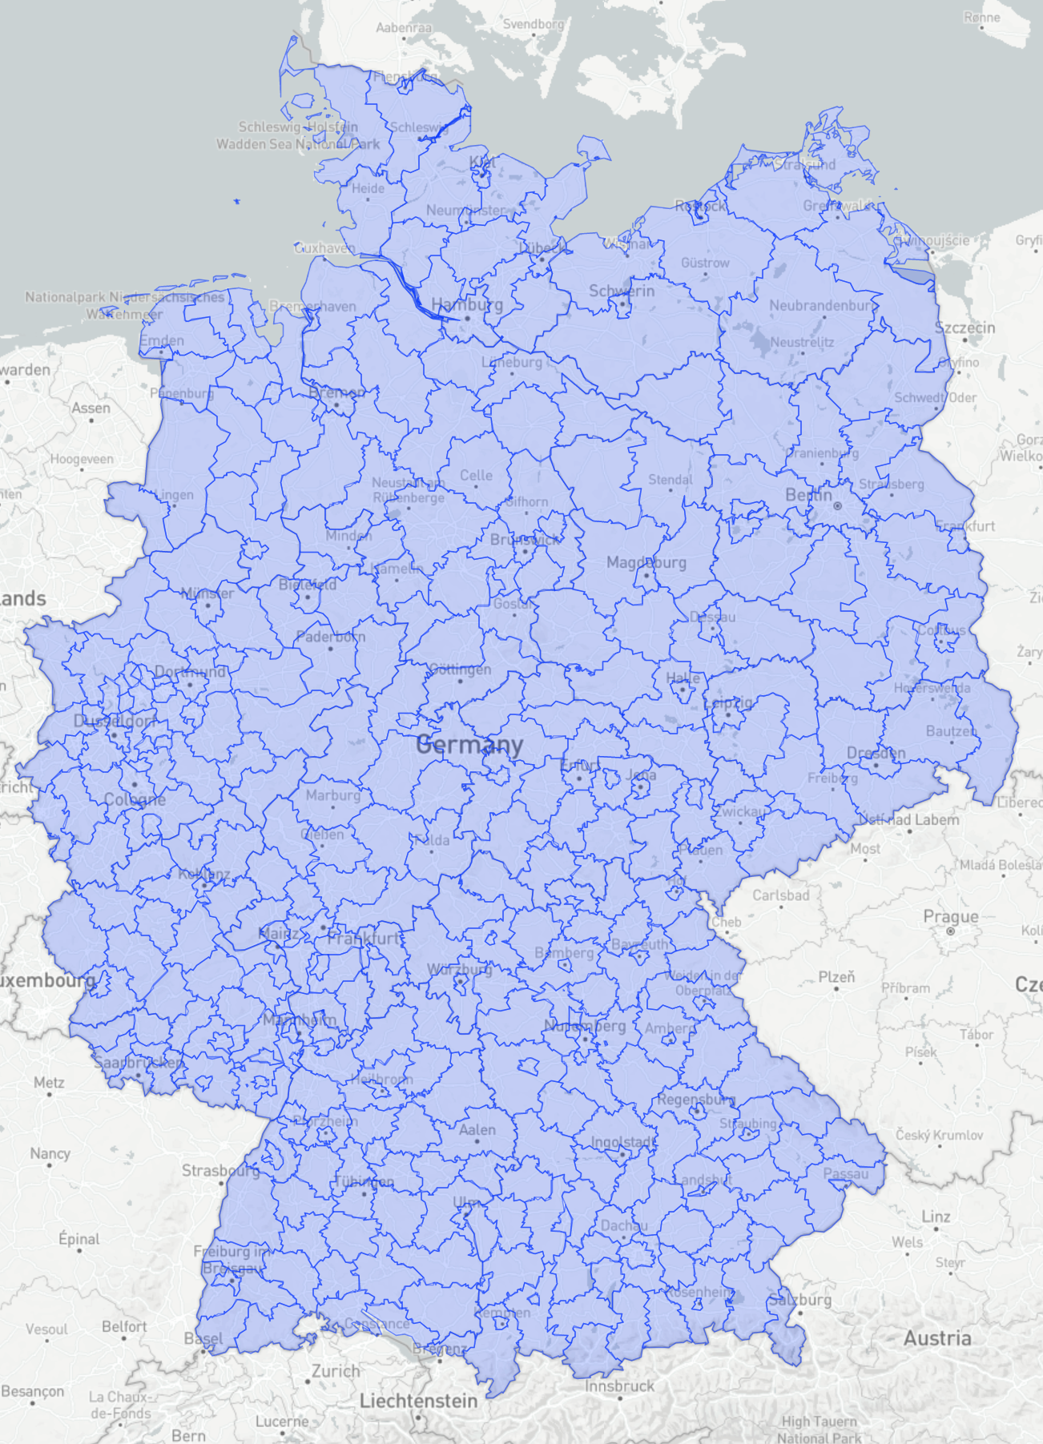
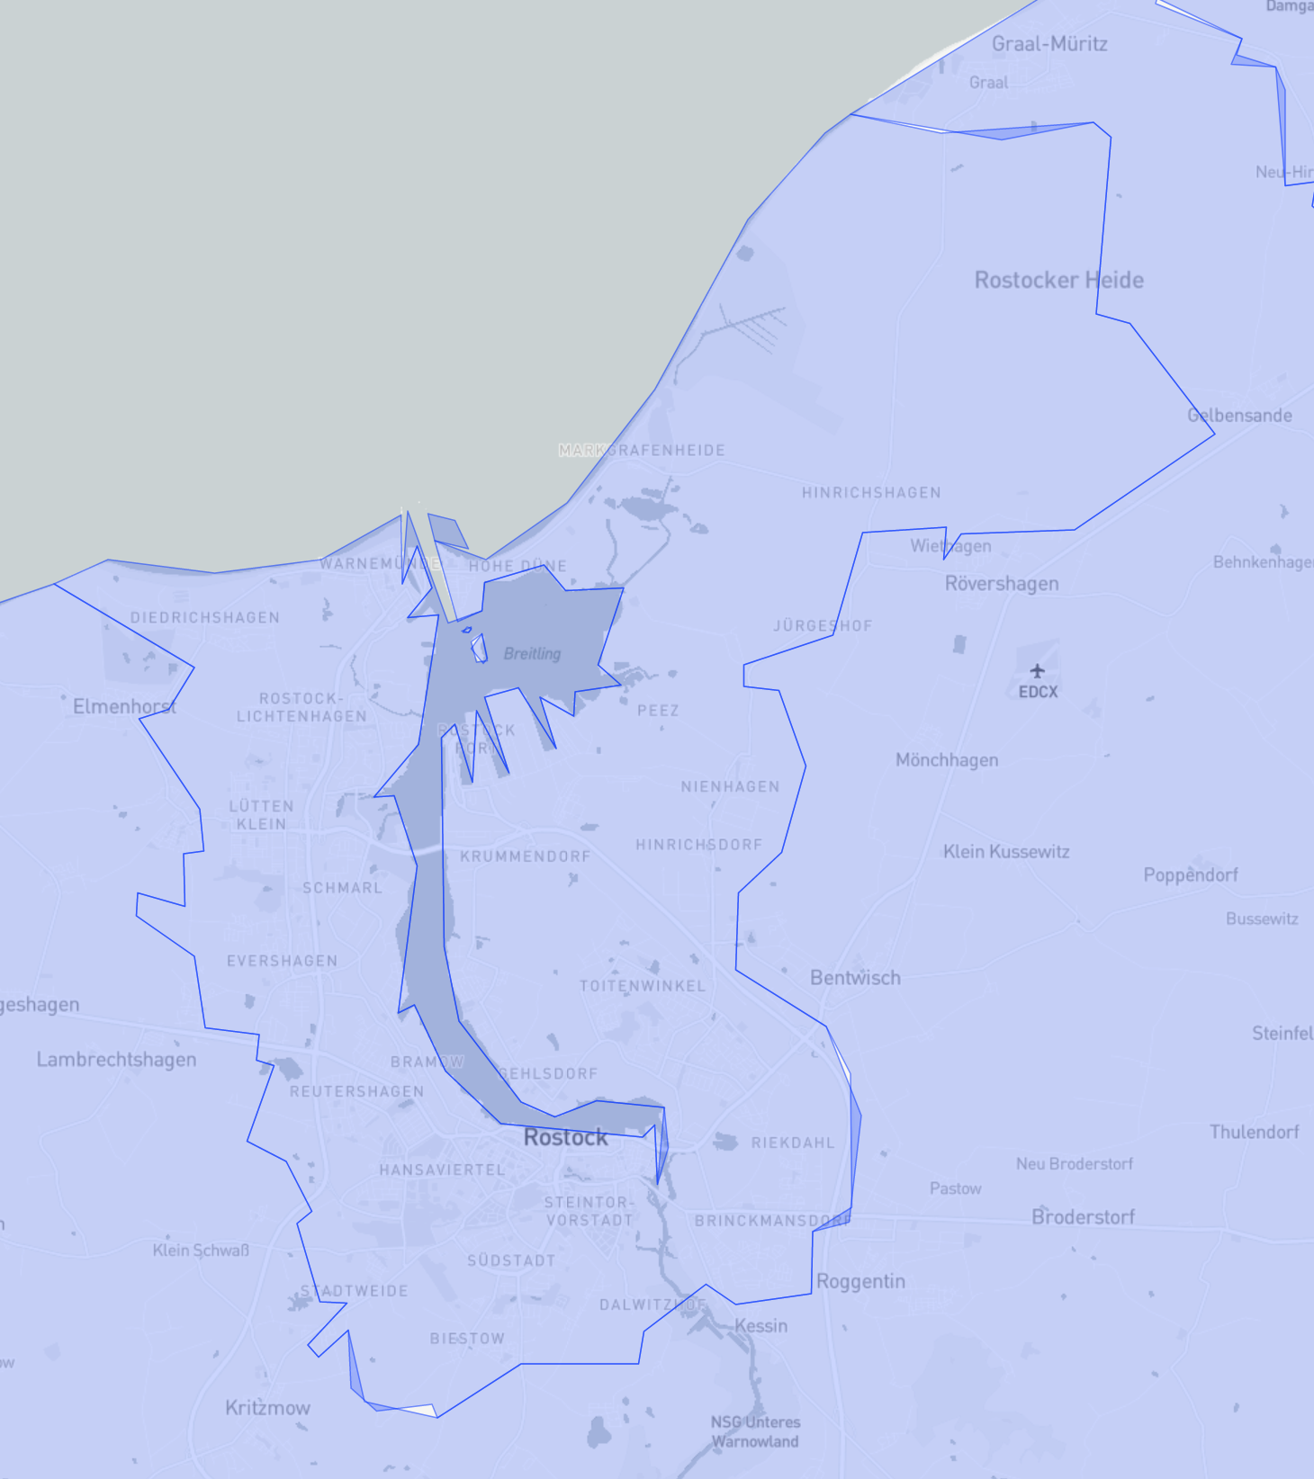
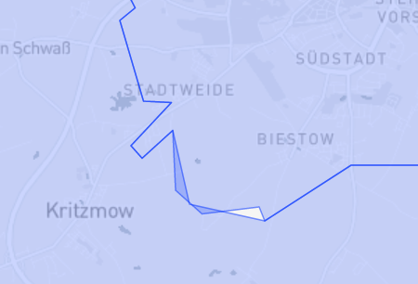
Representing geo-space
Geo-JSON
Advantages
Standardized format
Supported by various libraries and frameworks
Disadvantages
Redundancy in the data
Inconsistencies
Increased memory footprint
http://opendatalab.de/projects/geojson-utilities/

Slide 15
Representing geo-space
Geo-JSON
Redundancy in the data
Shared boundaries of neighboring regions is stored twice
Think about: How can the redundancy problem be solved?
Shared boundary
Shared boundary

Slide 16
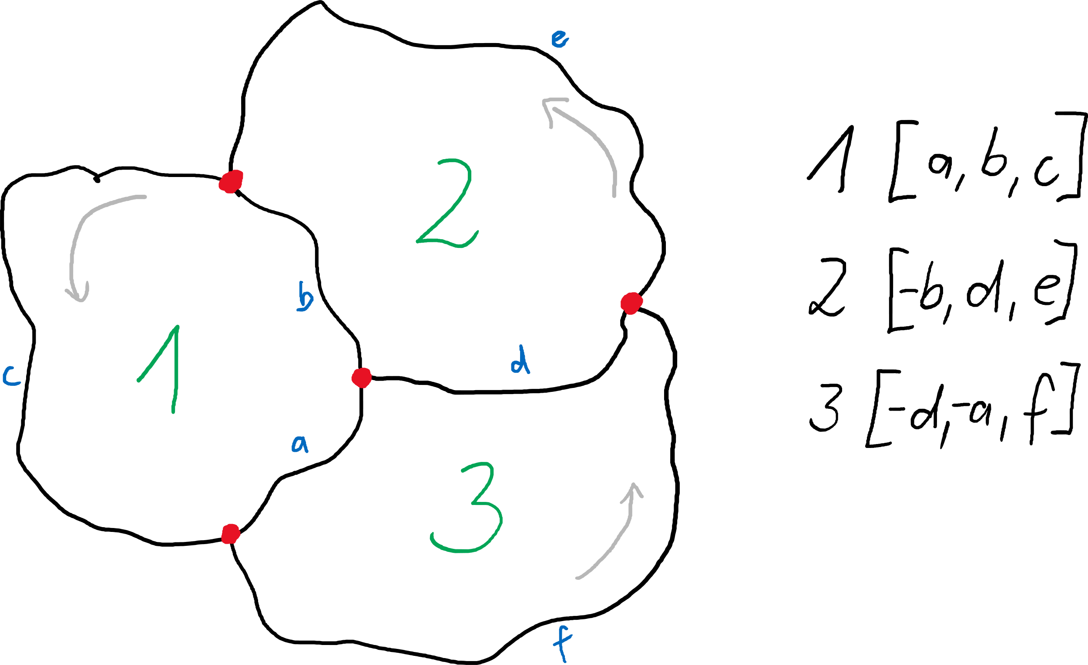
Representing geo-space
Topo-JSON
Redundancy-free topological definition
Geometry partitioned into line segments, so-called arcs
Arcs correspond to shared boundaries
Geometric primitives defined as list of arc references ( “-” indicates inverse direction)
https://bost.ocks.org/mike/topology/

Slide 17
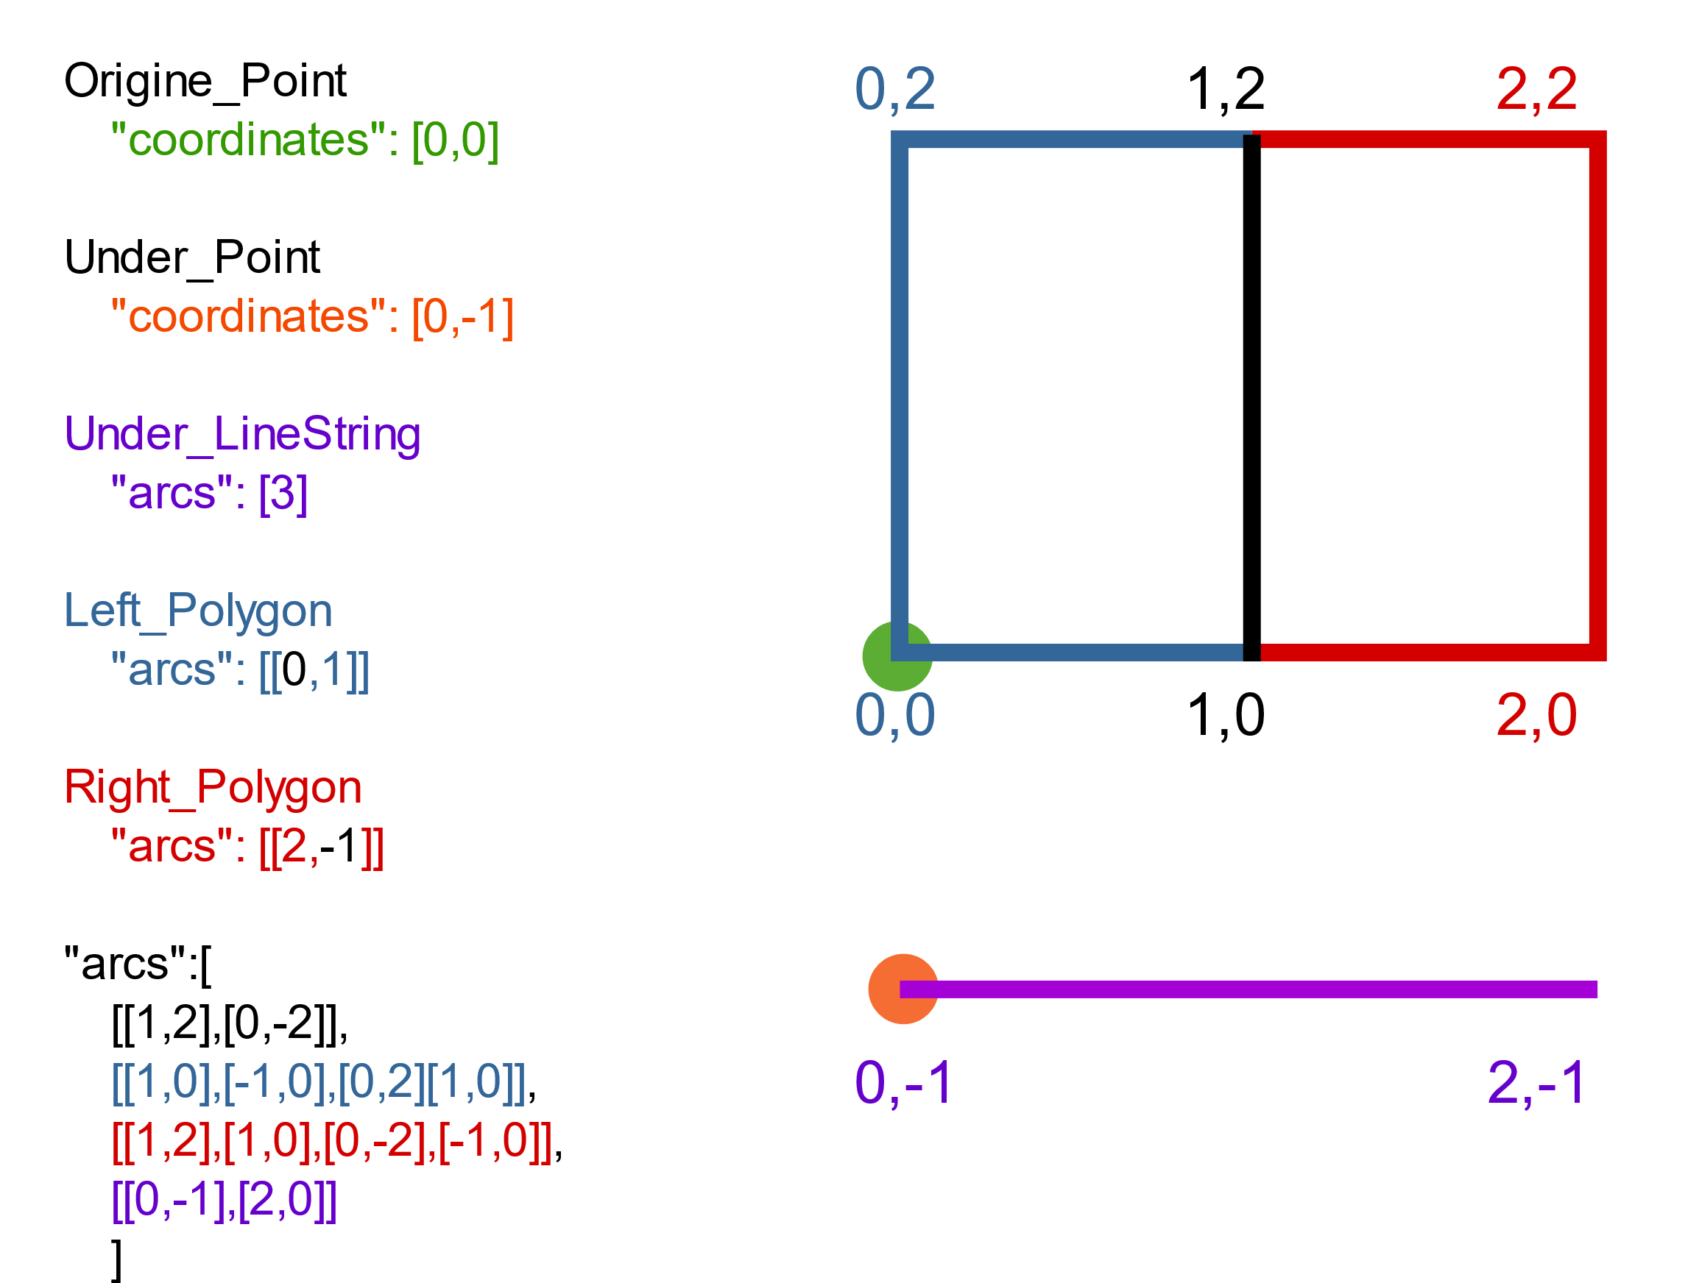
Representing geo-space
{ "type":"Topology", "transform":{ "scale": [1,1], "translate": [0,0] }, "objects":{ "two-squares":{ "type": "GeometryCollection", "geometries":[ {"type": "Polygon", "arcs":[[0,1]],"properties": {"name": "Left_Polygon" }}, {"type": "Polygon", "arcs":[[2,-1]],"properties": {"name": "Right_Polygon" }} ] }, "one-line": { "type":"GeometryCollection", "geometries":[ {"type": "LineString", "arcs": [3],"properties":{"name":"Under_LineString"}} ] }, "two-places":{ "type":"GeometryCollection", "geometries":[ {"type":"Point","coordinates":[0,0],"properties":{"name":"Origine_Point"}}, {"type":"Point","coordinates":[0,-1],"properties":{"name":"Under_Point"}} ] } }, "arcs": [ [[1,2],[0,-2]], [[1,0],[-1,0],[0,2],[1,0]], [[1,2],[1,0],[0,-2],[-1,0]], [[0,-1],[2,0]] ] }
Topo-JSON
“-” indicates inverse direction of arc
First coordinate is absolute, following coordinates are relative
https://en.wikipedia.org/wiki/GeoJSON

Slide 18
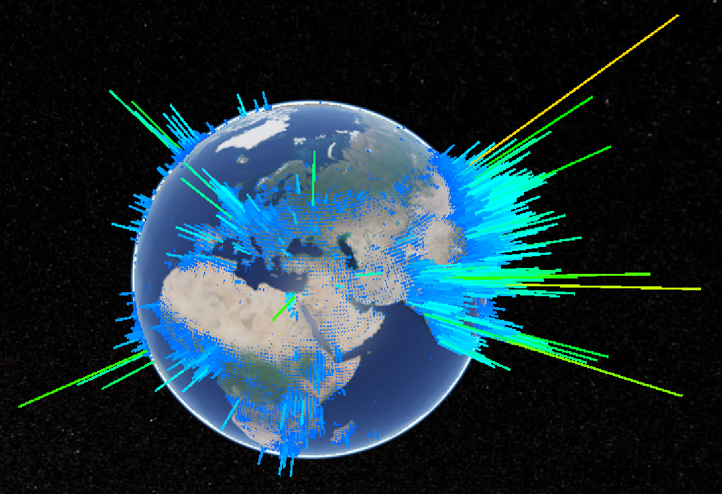
Representing geo-space
Fundamental options for representing geo-space
2D maps
Represent latitude and longitude
3D terrain rendering and globes
Represent latitude, longitude, and elevation
https://sandcastle.cesium.com/?src=Custom%20DataSource.html
By Steve Dübel. Licensed under CC BY.

Slide 19
Representing geo-space
Fundamental options for representing geo-space
Representing geo-space often involves cartographic projection
Polar geographic coordinates ($λ,φ$) must be projected to Cartesian display coordinates ($x,y$)
Earth’s properties should be preserved
Area
Shape
Direction
Distance
Because there is no optimal solution, different cartographic projections make different compromises (https://en.wikipedia.org/wiki/List_of_map_projections)

Slide 20
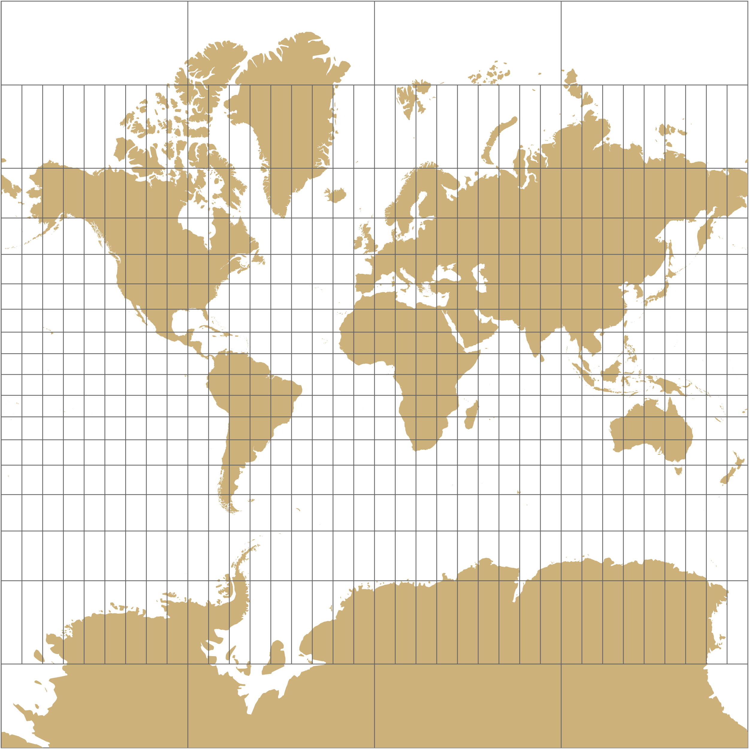
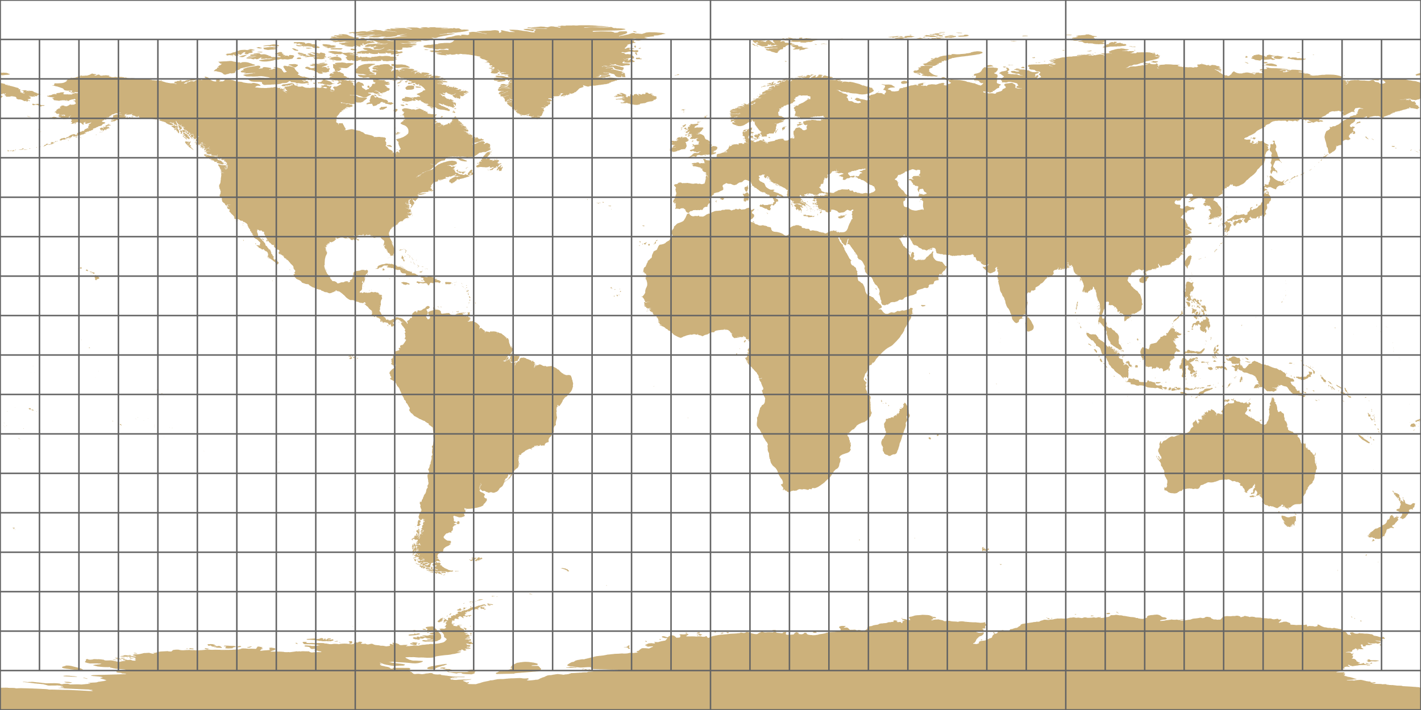
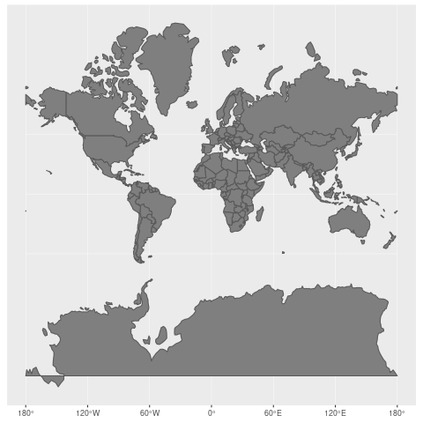
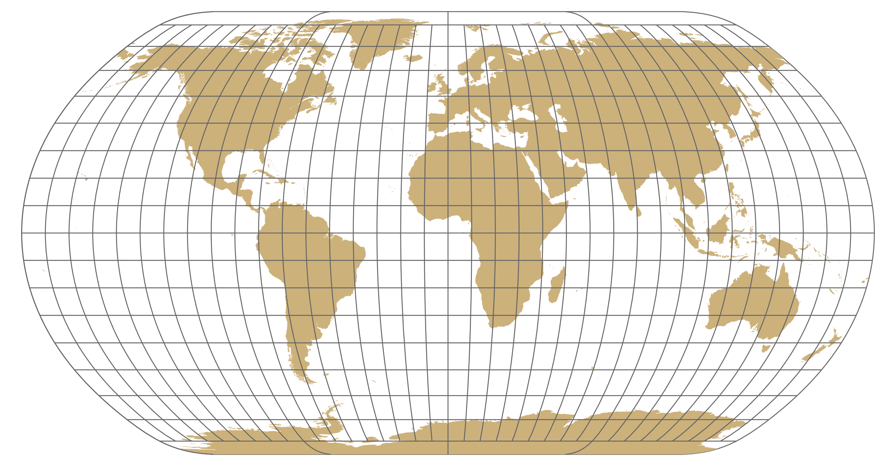
Representing geo-space
Map projections
Mercator
Equirectangular
Natural Earth
https://commons.wikimedia.org/wiki/File:Worlds_animate.gif

Slide 21
Representing geo-space
Map projections
Myriahedral projections (van Wijk, 2008)
https://philogb.github.io/page/myriahedral/

Slide 22
Representing geo-space
Geo-spatial phenomena can occur at different and even varying scales
Think about: What is the consequence for the representation of the geo-space?
The representation of the geo-space must be scalable
Show details at fine scale
Show basic properties at coarse scale
Question: How to adapt the representation to different scales?
Answer: Cartographic generalization

Slide 23
Representing geo-space
Cartographic generalization
Abstract spatial information at a high level of detail to information that can be rendered on a map at a lower level of detail
Various operators to reduce maps at lower levels of detail
Filter out smaller objects
Simplification geometries
Aggregation
…
Here we look at the example of simplification

Slide 24
Representing geo-space
Cartographic generalization
Simplification of cartographic features via the Douglas-Peucker algorithm
Start with first point $f$ and last point $l$
Find point $p$ with maximum distance $d_{p}$ to line segment $\overline{fl}$
Check
If $d_{p}≤ε$ all other points between $f$ and $l$ can be discarded
If $d_{p}>ε$ keep $p$ and proceed recursively with step 1. for the coordinates between
$f$ and $p$
$p$ and $l$
https://commons.wikimedia.org/wiki/File:Douglas-Peucker_animated.gif

Slide 25
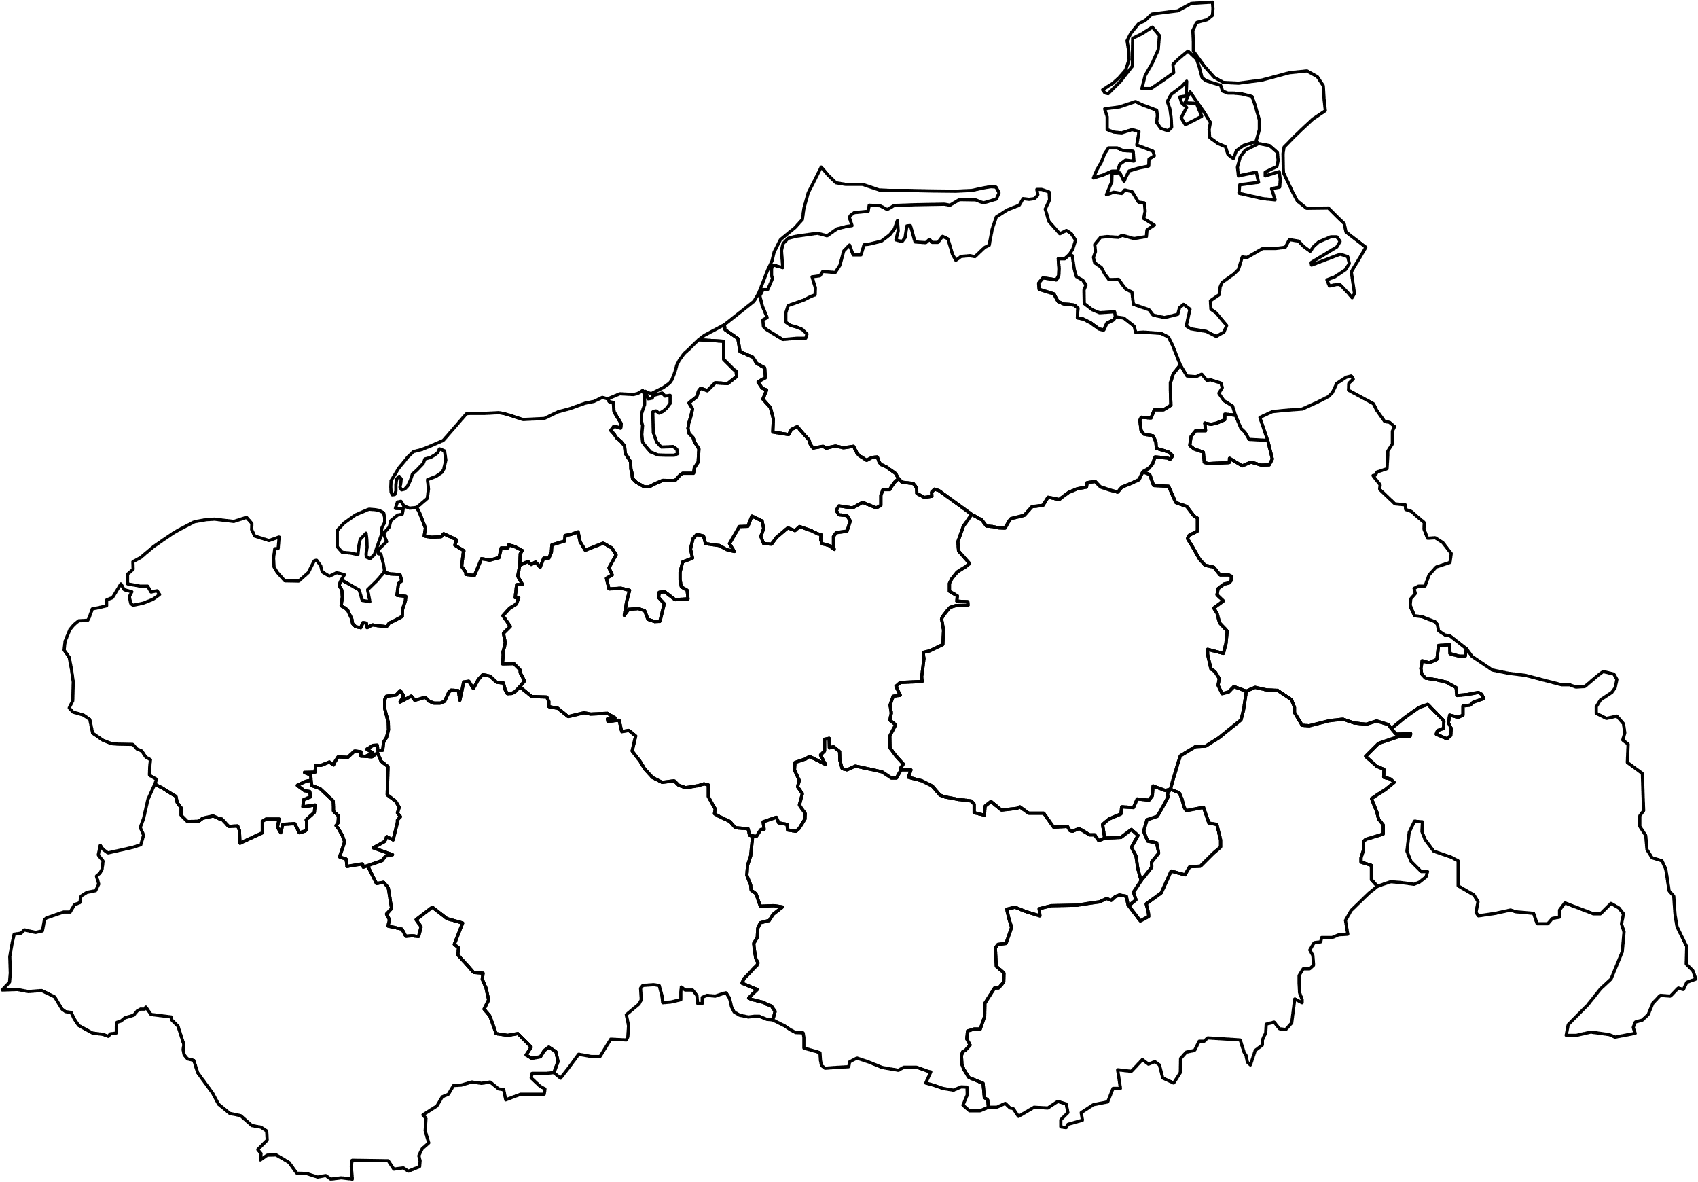
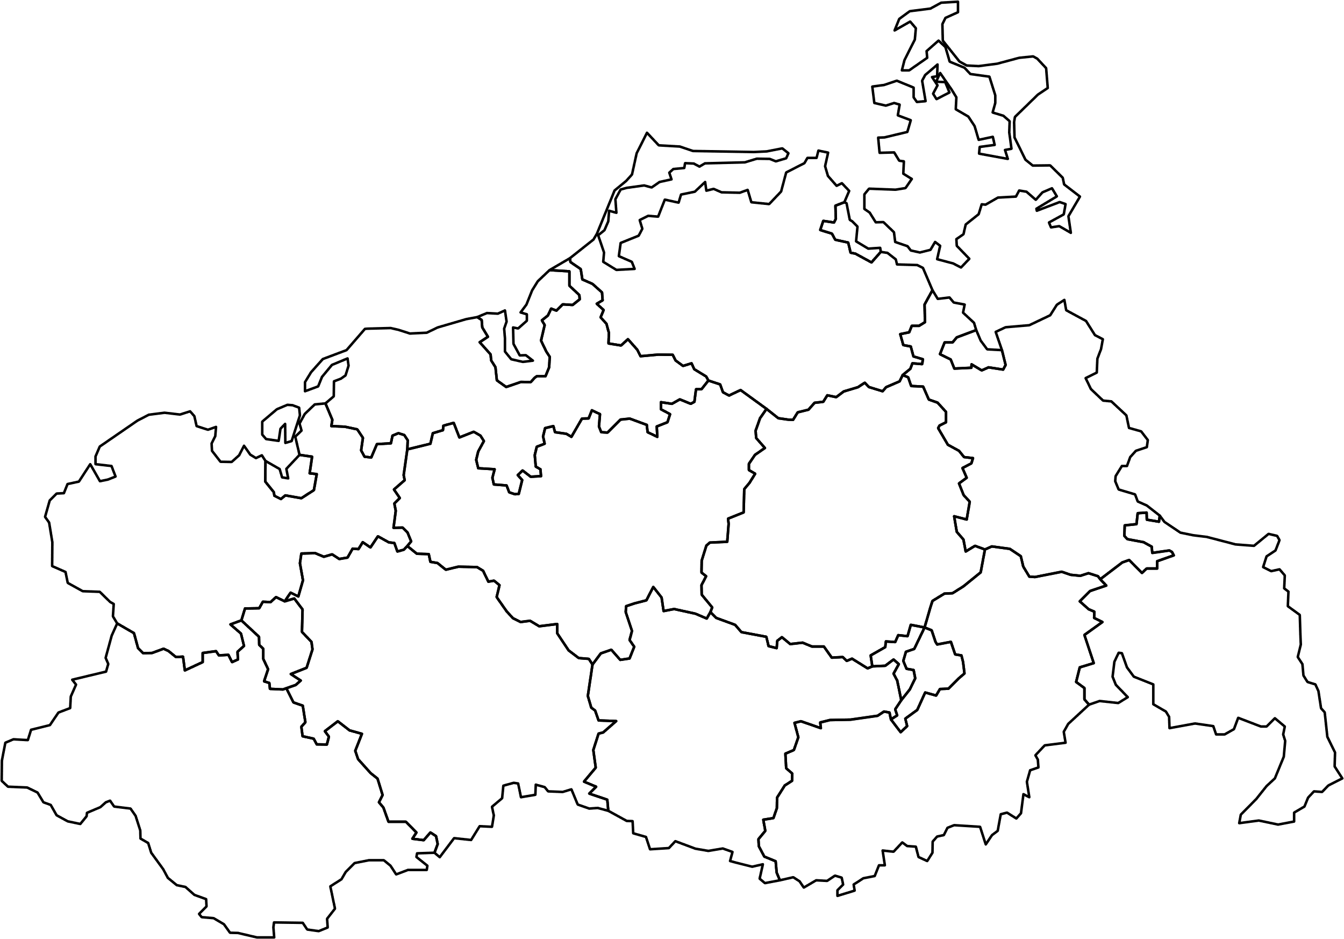
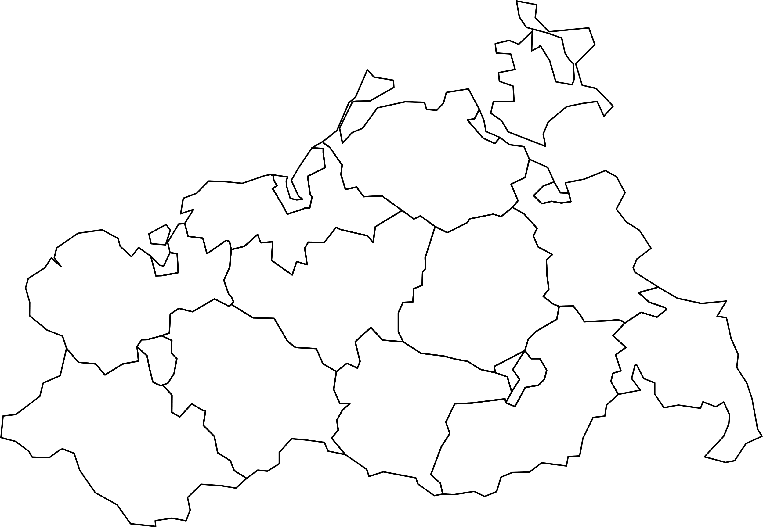
Representing geo-space
Cartographic generalization
Simplification results for GeoJSON data generated with https://mapshaper.org
Percentages represent roughly the reduction rate of the data
100%
50%
10%

Slide 26
General visualization strategies
Visualizing geo-spatial data requires:
Representing geo-space
Representing data in geo-space

Slide 27
Representing data in geo-space
When visualizing geo-spatial data attributes A, the key goal is to communicate their relationship to space S
We deal with two questions:
How to combine S and A?
Draw S and A in 2D or 3D?

Slide 28
Representing data in geo-space
1. How to combine S and A?
Direct visualization
Embed A directly in S
Examples
Univariate choropleth maps
Multivariate glyphs on maps
Indirect visualization
Show A and S in distinct, but visually linked views
Examples
Interactive highlighting
Probes

Slide 29
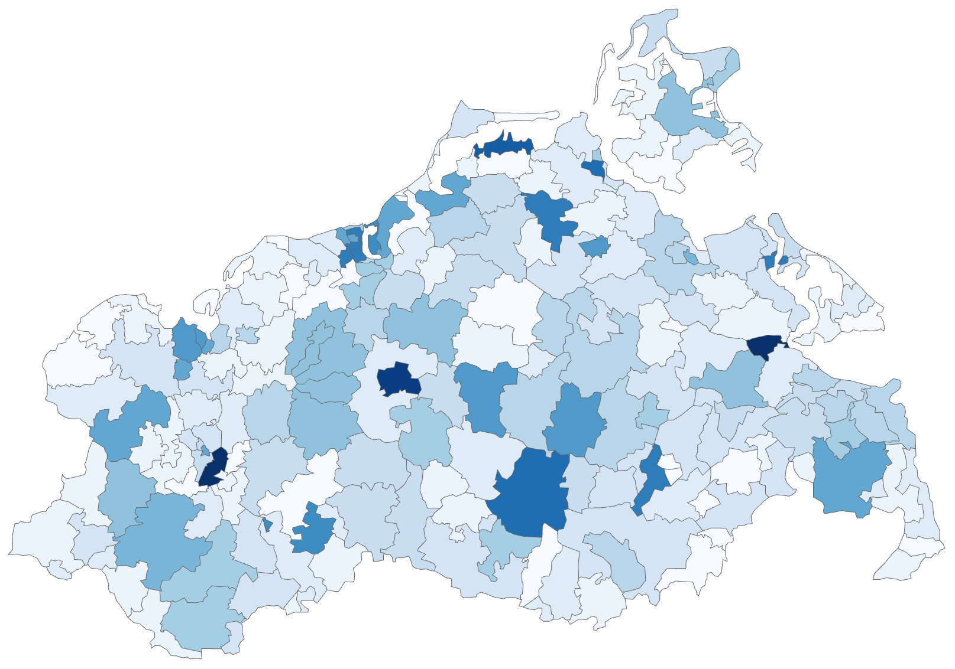
Representing data in geo-space
1. How to combine S and A?
Direct visualization: Univariate choropleth maps
Color-code (see Lecture 4) each region according to geo-spatial data attribute
Pros:
Intuitive, easy-to-interpret representation
Standard tools available
Cons:
Think about: What are cons here?
Represents only a single data value per spatial region
Size of region influences perception of colors

Slide 30
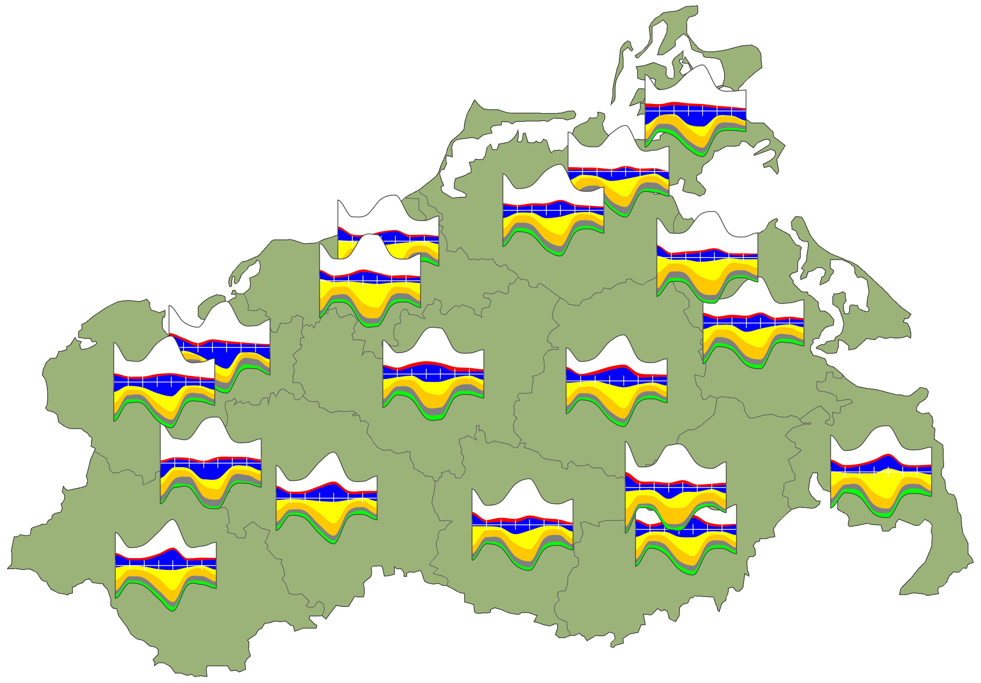
Representing data in geo-space
1. How to combine S and A?
Direct visualization: Multivariate glyphs on maps
Encode multivariate data as glyph (see Lecture 5)
Per spatial reference, place glyph directly on map
Pros:
Easy interpretation of spatial dependencies
Multiple data values per spatial reference
Cons:
Think about: What are cons here?
Small glyph size
Occlusion of glyphs (and map, but that’s by design)
Occlusion of information due to overlapping glyphs

Slide 31
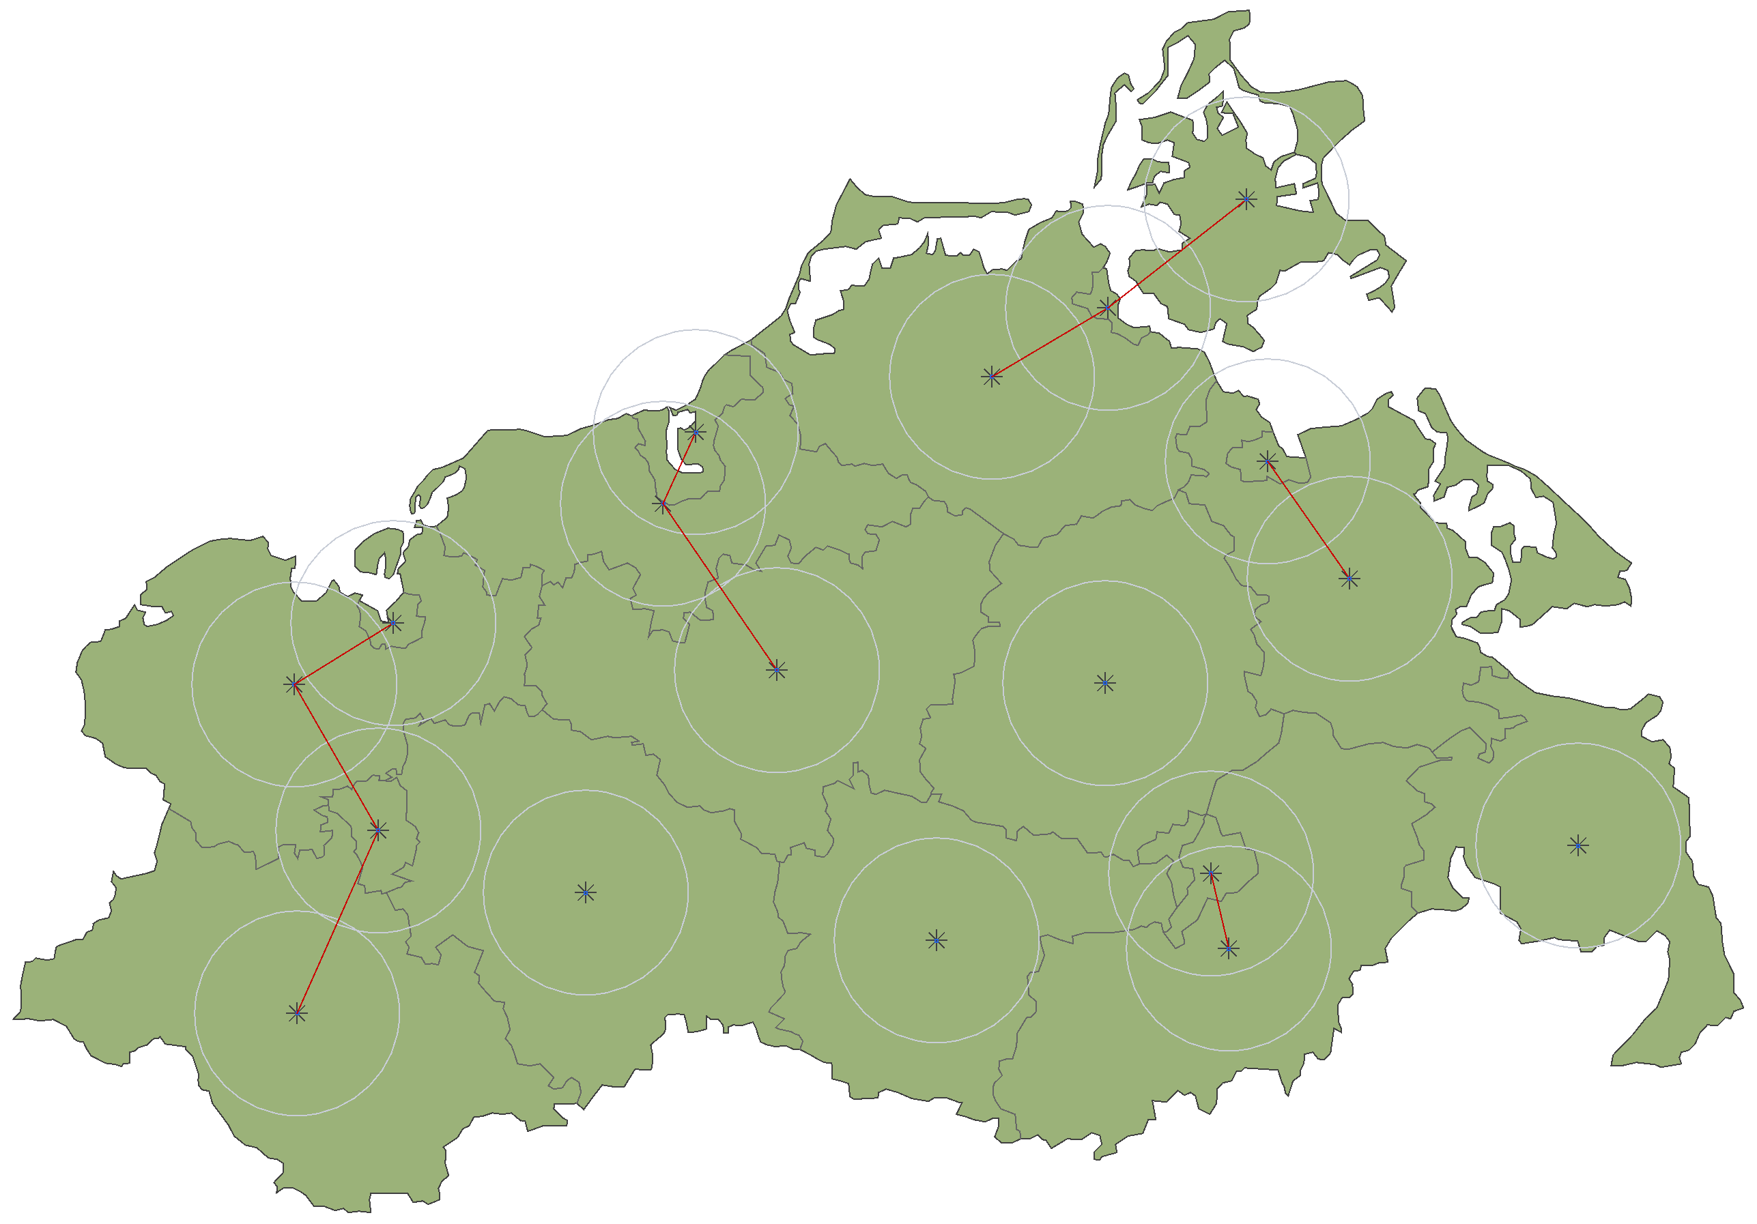
Representing data in geo-space
With overlap
Resolving glyph overlaps
Reduction of overlap is an NP-complete optimization problem
Heuristic approach via iterative process
Compute conflict graph of overlapping glyphs
Resolve conflicts by re-positioning glyphs
Repeat 1. and 2. until no more improvements possible
Reduced overlap

Slide 32
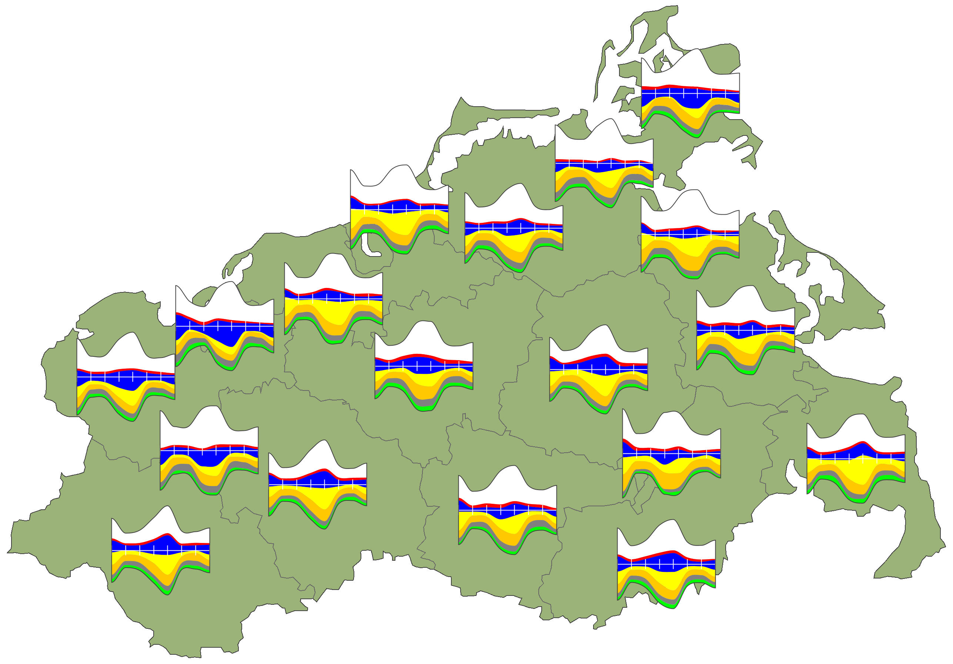
Representing data in geo-space
Resolving glyph overlaps
With overlap
Reduced overlap

Slide 33
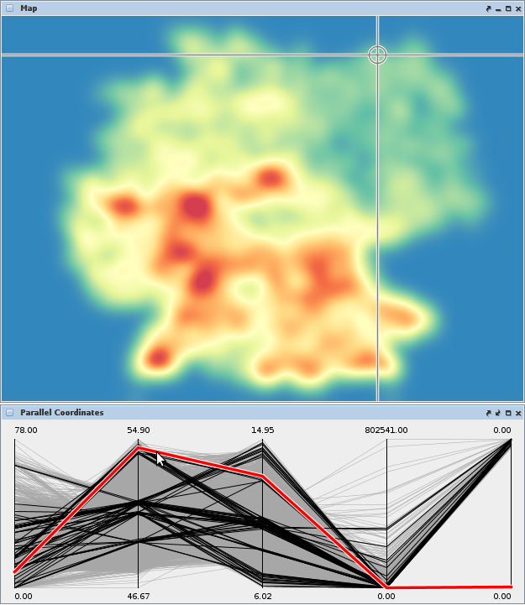
Representing data in geo-space
Selected data point highlighted in both views
1. How to combine S and A?
Indirect visualization: Interactive highlighting
Pros: Dedicated views for S and A
Cons: Correspondence of S and A visible only for single data point
Map visualization of space S
Parallel coordinates visualization of attributes A
Selected data point highlighted in both views

Slide 34
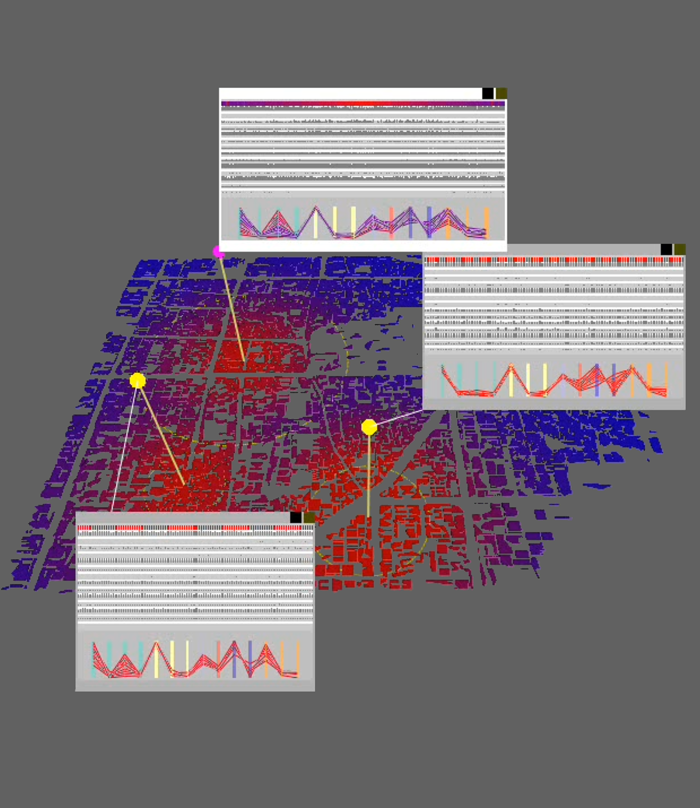
Representing data in geo-space
By Thomas Butkiewicz. Licensed under CC BY.
1. How to combine S and A?
Indirect visualization: Probes (Butkiewicz, 2008)
Pros: Spatial dependencies visible for several spatial locations
Cons: Occlusion
Map visualization of space S
Probes at selected points in space S
Visual linking between probe and view
Dedicated view for data attributes A

Slide 35
Representing data in geo-space
1. How to combine S and A?
Summary
Direct visualization
Direct connection of S and A
Limited in terms of how rich the attribute representation can be
Indirect visualization
Dedicated view for attributes possible
Interpreting the relation between S and A requires additional mental effort

Slide 36
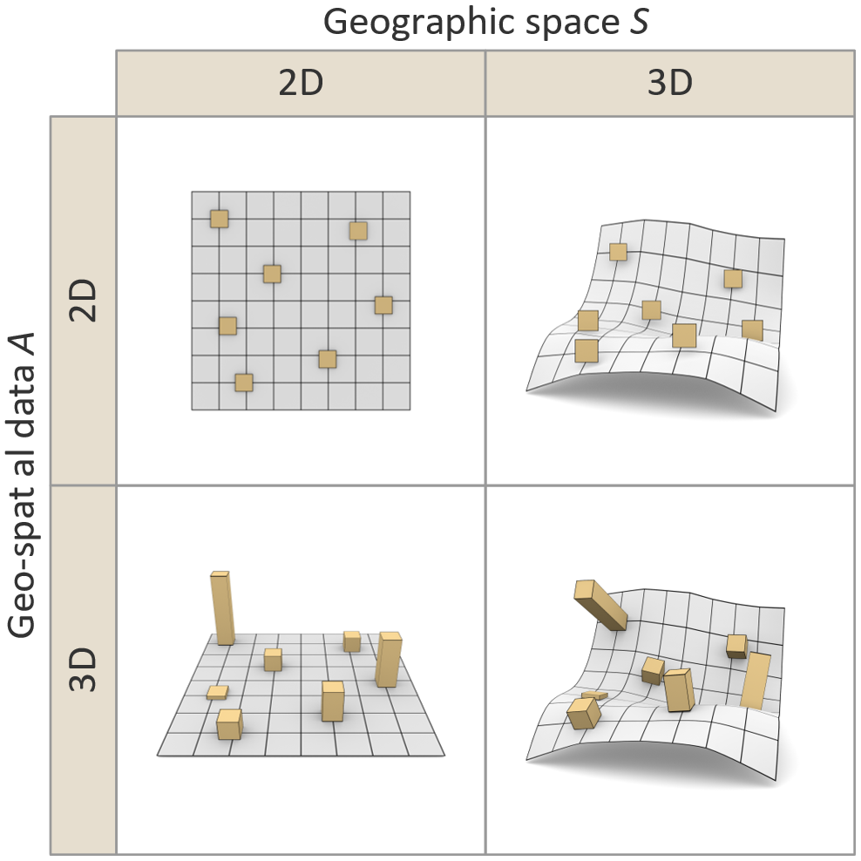
Representing data in geo-space
2. Draw S and A in 2D or 3D?
Technically, four different combinations possible

Slide 37
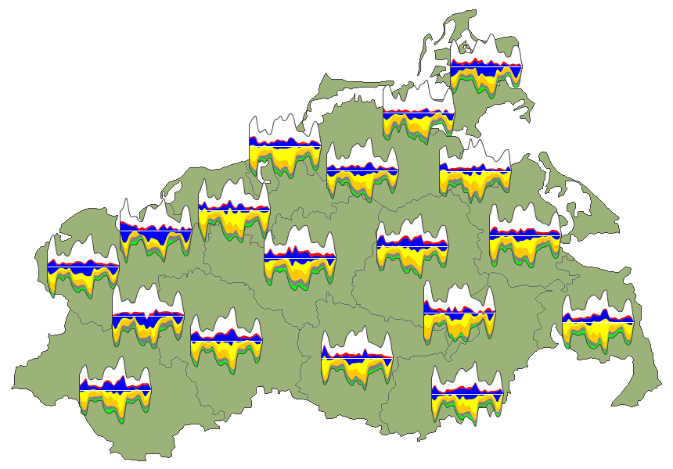
Representing data in geo-space
2. Draw S and A in 2D or 3D?
S: 2D map
A: 2D glyphs

Slide 38
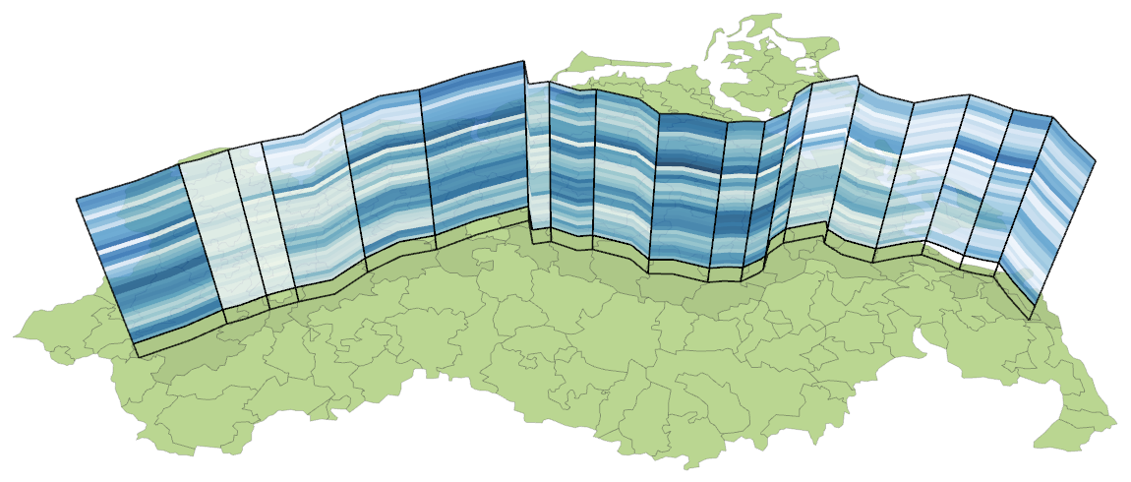
Representing data in geo-space
2. Draw S and A in 2D or 3D?
S: 2D map
A: 3D color-coded wall

Slide 39
Representing data in geo-space
2. Draw S and A in 2D or 3D?
S: 3D terrain; A: 2D color-coded texture
By Steve Dübel. Licensed under CC BY.

Slide 40
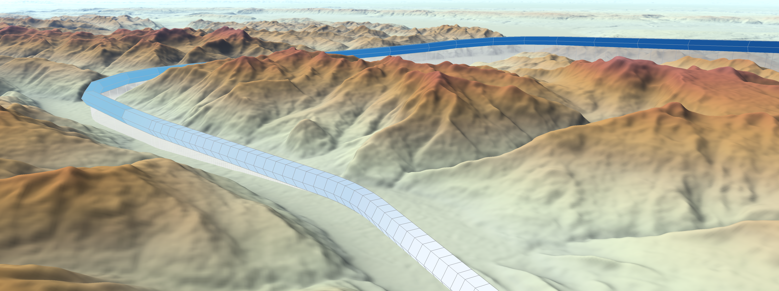
Representing data in geo-space
2. Draw S and A in 2D or 3D?
S: 3D terrain; A: 3D color-coded trajectory
By Steve Dübel. Licensed under CC BY.

Slide 41
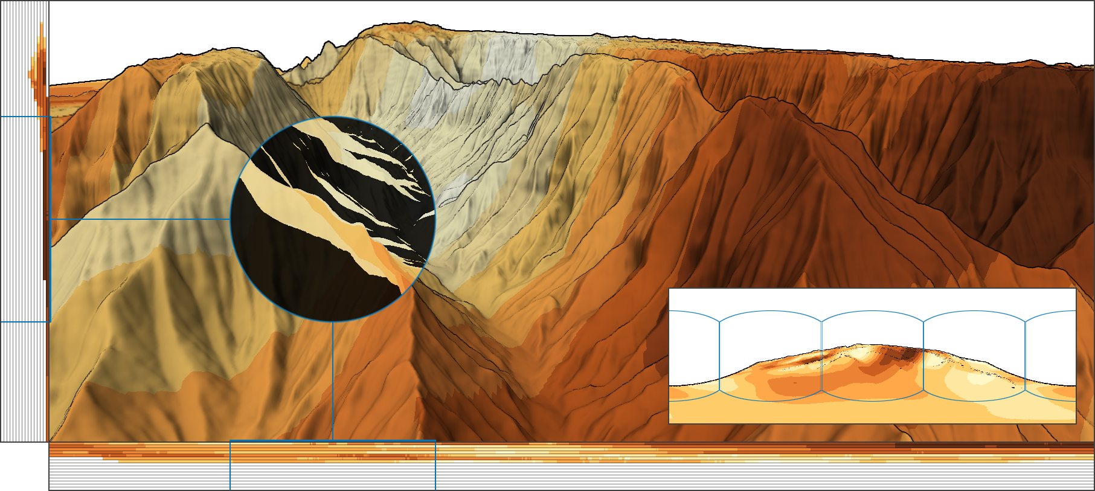
Representing data in geo-space
3D visualizations need tools to reveal hidden information
Visibility widgets
Visibility lens: Reveal hidden back-face information
Visibility panorama: Shows information hidden behind the camera
Visibility bands: Show aggregated amount of hidden information at different distances
Visibility bands
Röhlig & Schumann, 2017
Visibility panorama
Visibility lens
By Martin Röhlig. Licensed under CC BY.

Slide 42
Overview
Visualization of geo-spatial data
Geographic space and geo-spatial data
General visualization strategies
Representing geo-space
Representing data in geo-space
Visualizing spatio-temporal data (S and T)

Slide 43
Visualizing spatio-temporal data
So far, we considered temporal data and spatial data separately
Now, we consider the joint visualization of spatio-temporal data, that is, data with spatial and temporal dependencies
In addition to understanding T → A and S → A, we now seek to understand S × T → A
Visualization becomes more challenging, because T and S and A must be analyzed simultaneously

Slide 44
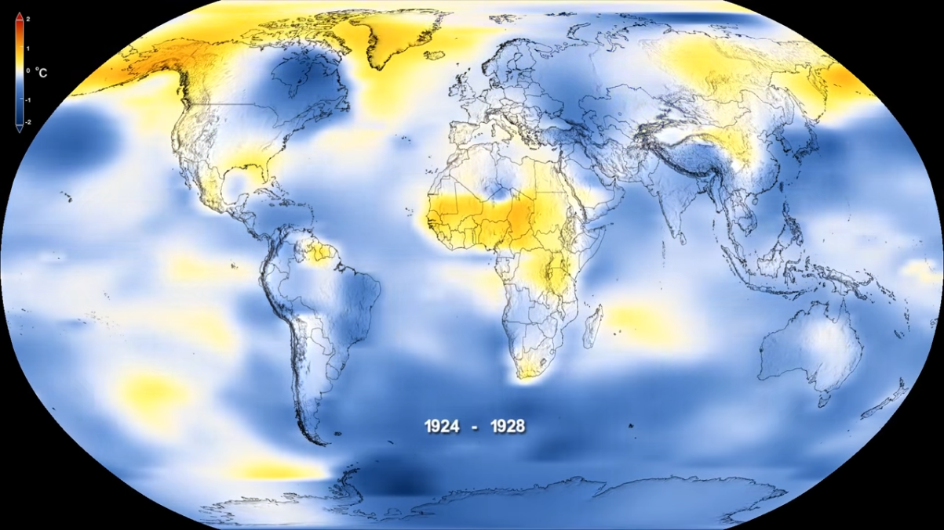
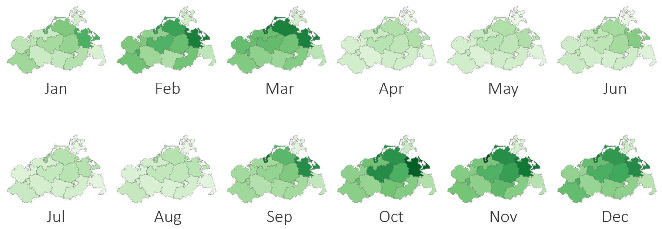
Visualizing spatio-temporal data
Fundamental 2D visualization approaches
Visualize space S and attributes A via map
Options for visualizing time T
Utilize display time:
Dynamic time-to-time mapping
Present animated map
Utilize display space:
Create miniature maps
Present multiple miniature maps
https://www.youtube.com/watch?v=gXXOkhoki8s
We called this small multiples in Lecture 6.

Slide 45
Visualizing spatio-temporal data
Fundamental 3D visualization approaches
Directly integrate S, T, and A
Utilize 3rd dimension for:
Stacking spatio-temporal data
Mapping time
We briefly look at
Stacking-based visualization
Space-time cube visualization

Slide 46
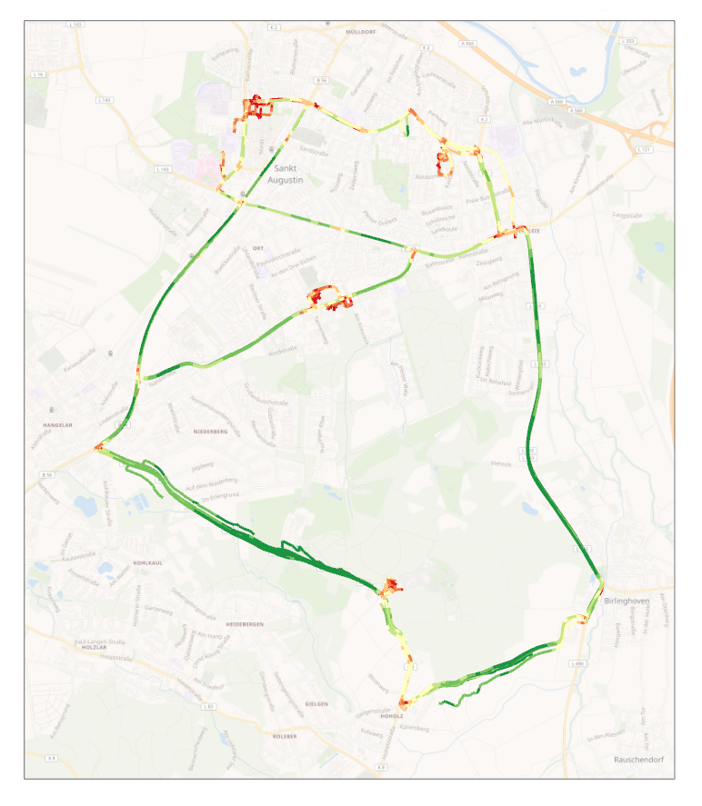
Visualizing spatio-temporal data
Example data: Spatio-temporal movement trajectories
Example tasks:
Where are movements located?
When do movements take place?
How fast are things moving?
Standard vis.: Colored lines on 2D map
Problems of standard visualization
Over-plotting of trajectories
Time hardly visible

Slide 47
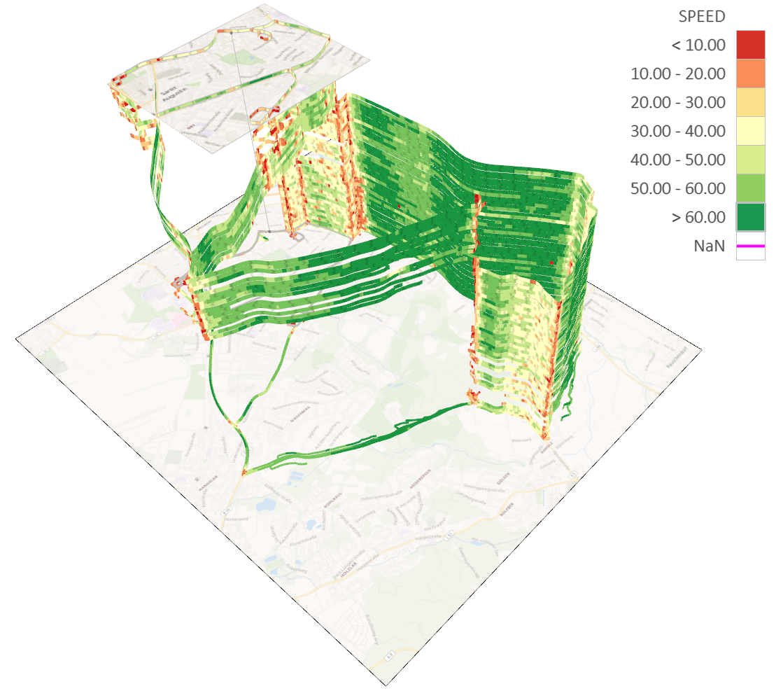
Visualizing spatio-temporal data
(Relative) time T represented via small arrows embedded in trajectory bands
Stacking-based visualization
Stacking* is a general visualization strategy to reduce over-plotting.
(Relative) time T represented via order of trajectory bands
Geo-space S shown as 2D map in 3D space
Spatio-temporal data attribute A color-coded along stacked trajectory bands
*For more information on stacking in general, see https://doi.org/10.1109/TVCG.2010.197
https://vcg.informatik.uni-rostock.de/~ct/pub_files/Tominski12TrajectoryVis_video.m4v

Slide 48
Visualizing spatio-temporal data
Stacking-based visualization
Via stacking, we can represent ordered time, that is, qualitative temporal information is communicated
Think about: How to represent quantitative temporal information?
Possible answer: Space-time cube visualization

Slide 49
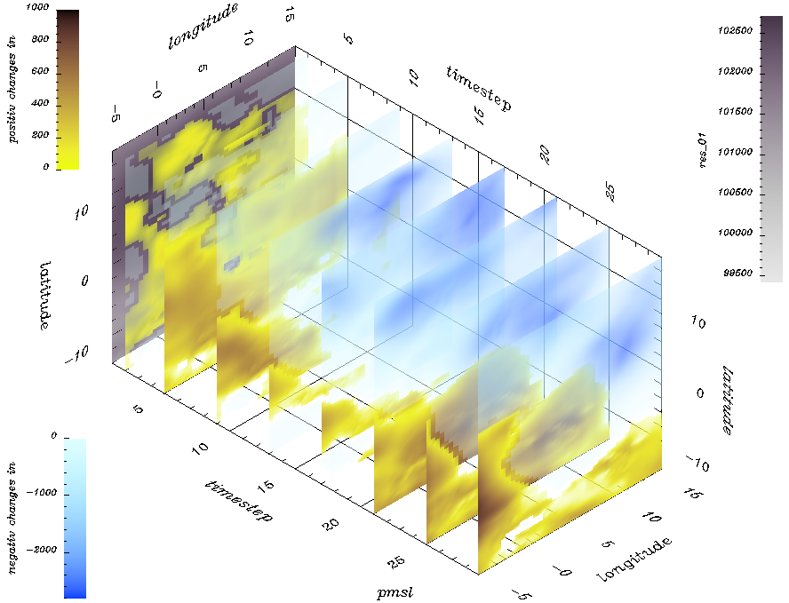
Visualizing spatio-temporal data
Space-time cube visualization
Fundamental idea
Cube visualization
Two dimensions show space S
Third dimension show time T
Attribute visualization embedded into cube
By Thomas Nocke.

Slide 50
Visualizing spatio-temporal data
Example data: Spatio-temporal human health data
Space: Mecklenburg-Vorpommern (federal state, districts, zip-code regions)
Time: Daily data for three years (yearly, quarterly, monthly, weekly aggregations)
Attributes: Diagnoses classified according to ICD-10 schema
Example tasks:
Where do many cases occur?
Are there temporal trends?
What diagnoses show comparable behavior?
Space-time cube visualizations
Pencil and helix glyphs on map
Great wall of space-time

Slide 51
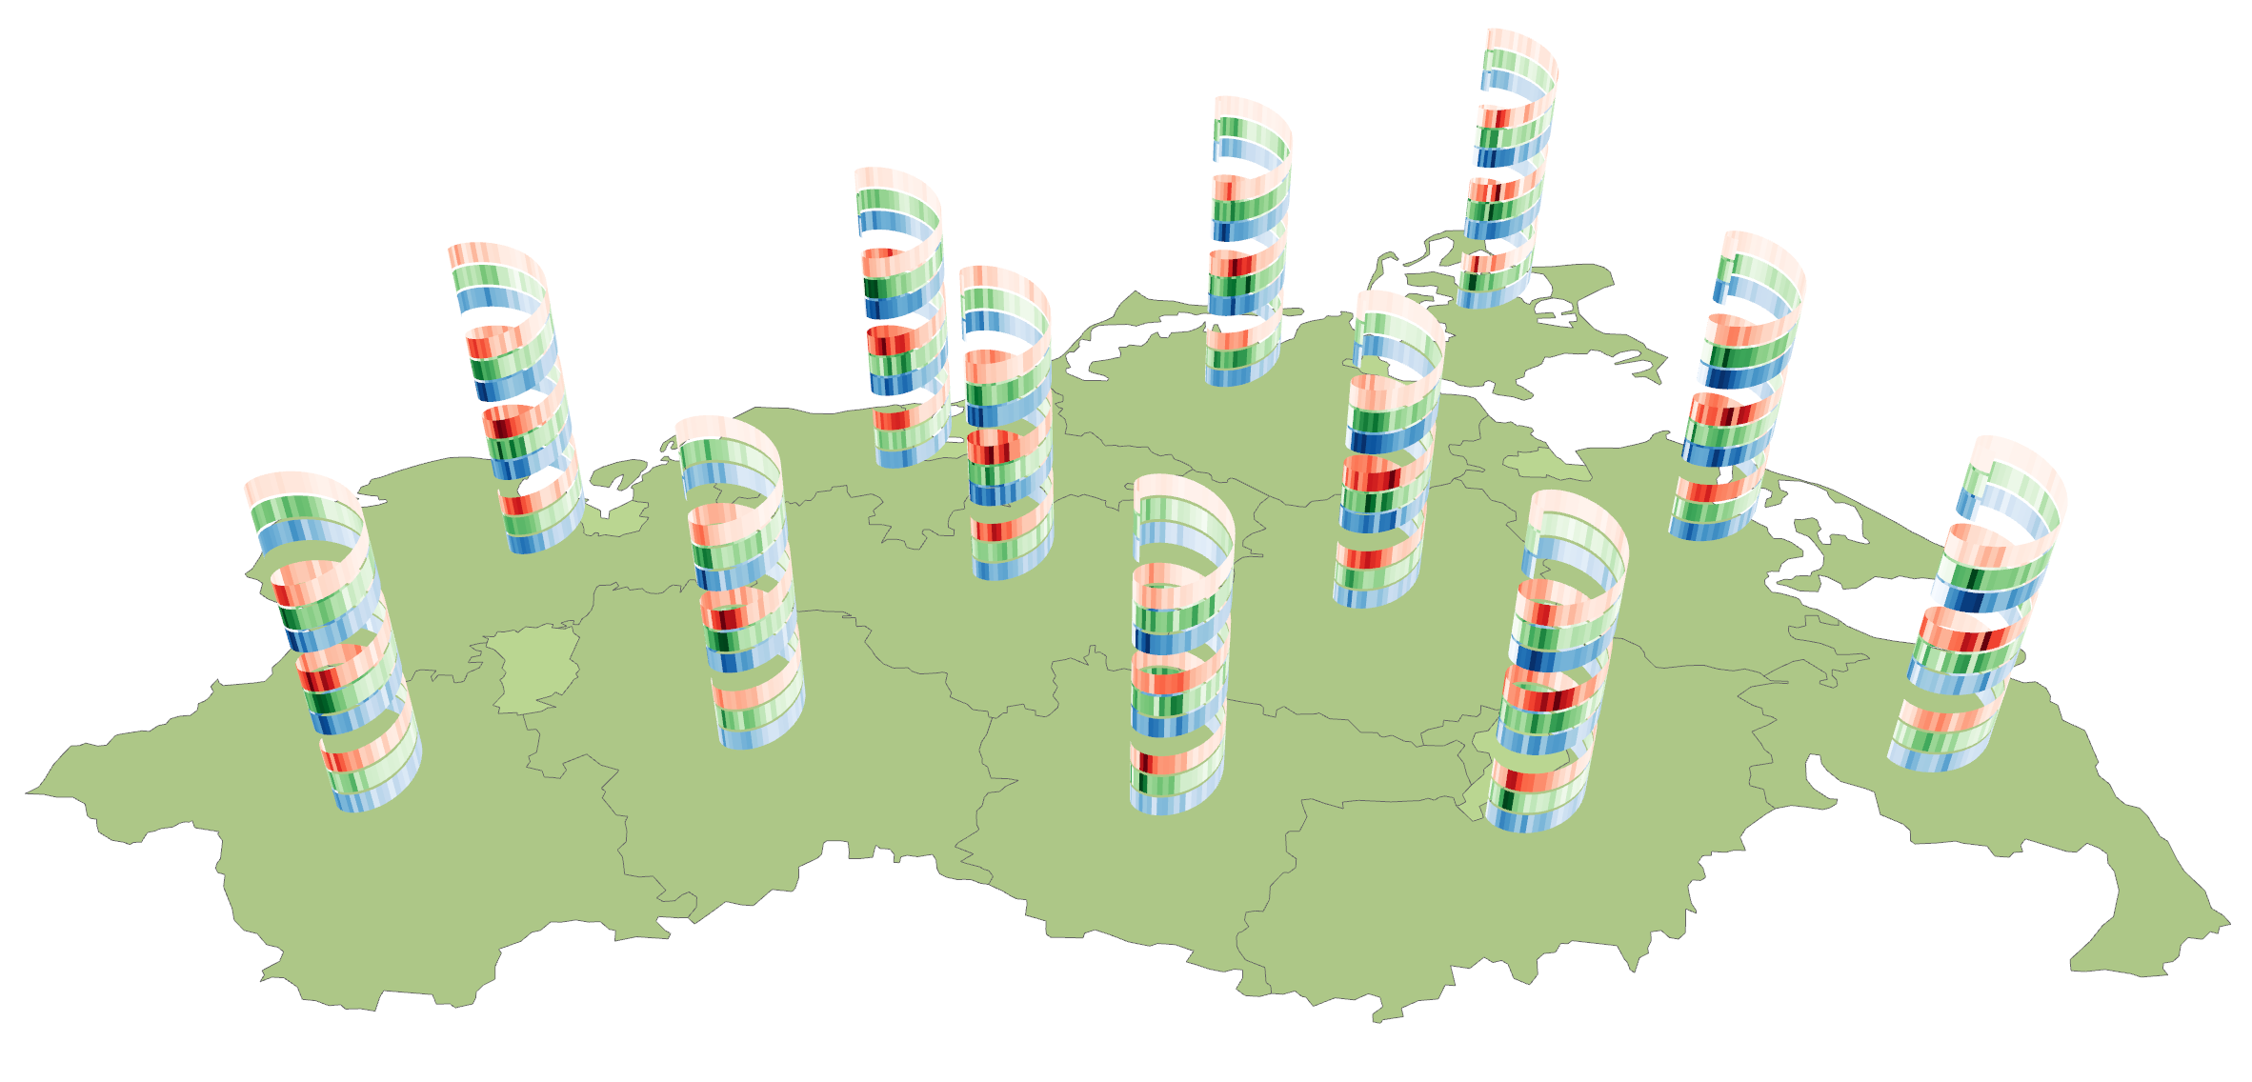
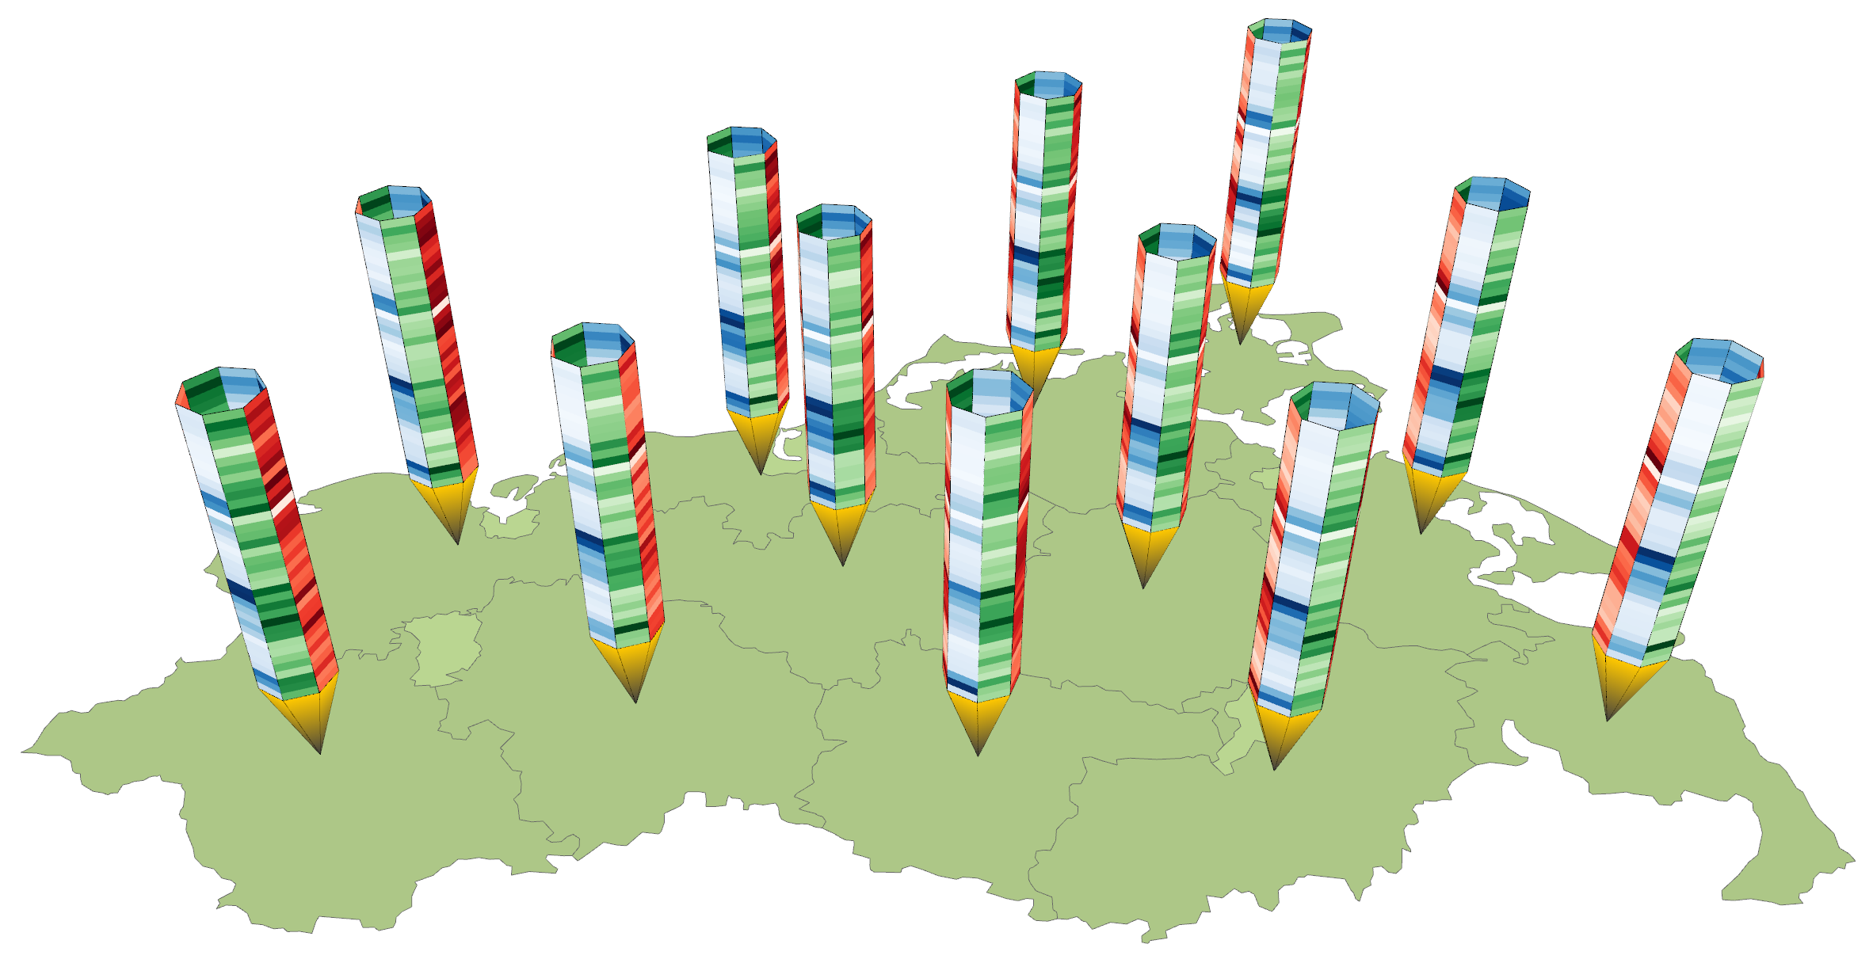
Visualizing spatio-temporal data
Space-time cube visualization
Helix glyphs for cyclic time
Pencil glyphs for linear time
The gap between glyphs can hinder the understanding of spatial patterns. What can we do about it?

Slide 52
Visualizing spatio-temporal data
Space-time cube visualization
Great wall of space-time
Topological path
Geometrical path
Extruded slice

Slide 53
Visualizing spatio-temporal data
No more gaps, but only along selected path through space. Bottom line: Designing visual representations of spatiotemporal data usually involves compromises.
Space-time cube visualization
Great wall of space-time

Slide 54
Summary
Visualization of geo-spatial data
Geographic space and geo-spatial data
General visualization strategies
Representing geo-space
GeoJSON, TopoJSON
Map projections, cartographic generalization
Representing data in geo-space
Direct and indirect visualization
2D and 3D visualization
Visualizing spatio-temporal data
2D: Animated maps, small multiples
3D: Stacking-based visualization, space-time cube visualization

Slide 55
Assignments
Explore myriahedral projections at https://philogb.github.io/page/myriahedral/!
Read about “Adaptive composite map projections” by Bernhard Jenny!
Read about “Visibility Widgets” by Röhlig et al.!
Explore examples of geo-visualization created with Cesium.js!

Slide 56
Questions
How is geographic space characterized?
What is GeoJSON?
How does TopoJSON reduce redundancy?
What is the purpose of map projections, which is the best one?
Sketch the basic idea of the Douglas-Peucker algorithm!
What is direct visualization in contrast to indirect visualization of geo-spatial data?
How do probes represent data in geo-space?
What are visibility widgets good for?
What is the challenge of visualizing spatio-temporal data?
What is the basic idea of space-time cubes?
Describe how the Great wall of space-time is constructed!

